Slide 1
January 2025
Economic Overview www. GNODATACENTER.COM
CURRENT ASSESSMENT OF U.S., LOUISIANA, NEW ORLEANS MSA and CITY OF NEW ORLEANS
Prepared By
Dr. Raymond J. Brady
Systems SOLUTIONS
CONSULTING

Slide 2
October Update of the
U.S. 2025 Economic Outlook:
Key Words:
Inflation Expectations Mixed
Debt: No discussion on Managing
Consumer Spending Holding Up Because of a Mountain of Debt
Data: The Rear-View Mirror Problem

Slide 3

Annualized
Real GDP 3rd Quarter 2024 (3rd estimate) | 3.1%
Current-Dollar (seasonally adjusted) | 5.0%
Real GDP 3RD Quarter 2023 (3rd estimate) | 4.9%
Current-Dollars (annualized) | 8.5%
Source: Bureau of Economic Analysis
PCE Price Index (Change from Month Previous Year)
November 2024 | 2.4%
October 2024 | 2.3%
September 2024 | 2.1%
August 2024 | 2.3%
November 2023 | 2.9%
Source: Bureau of Economic Analysis
Percentage Change Seasonally Adjusted Expenditures in Food and Drinking Places
August 2019-August 2018 | 4.3%
August 2023-August 2022 | 9.4%
August 2024-August 2023 | 3.8%
Source: Federal Reserve Bank of St. Louis (current adjusted $)
Personal Savings as a % of Disposable Income (Seasonally Adjusted at Annual Rates)
August 2024 | 4.8%
August 2023 | 4.7%
August 2019 | 6.9%
Source: Bureau of Economic Analysis
SUMMARY OF
U.S. DATA

Slide 4
What does the 3rd quarter 2024 U.S. GDP
3rd Estimate Tell Us.
To quote the BEA Data Release:
“For both exports and imports, the revised estimates primarily reflected updated data from BEA’s International Transactions Accounts.”
“Within consumer spending, the upward revision was primarily to services, based on new third-quarter data from the Census Bureau Quarterly Services Survey. The leading contributor to the revision was final consumption expenditures of nonprofit institutions serving households.”
“Within private inventory investment, the downward revision was led by manufacturing, wholesale trade, and retail trade.”
Real Gross Domestic Product increased by an annualized rate of 3.1%, revised up from 2.8%
According to the BEA news release the latest growth rate “reflected upward revisions to exports and consumer spending that were partly offset by a downward revision to private inventory investment. Imports, which are a subtraction in the calculation of GDP, were revised.”

Slide 5
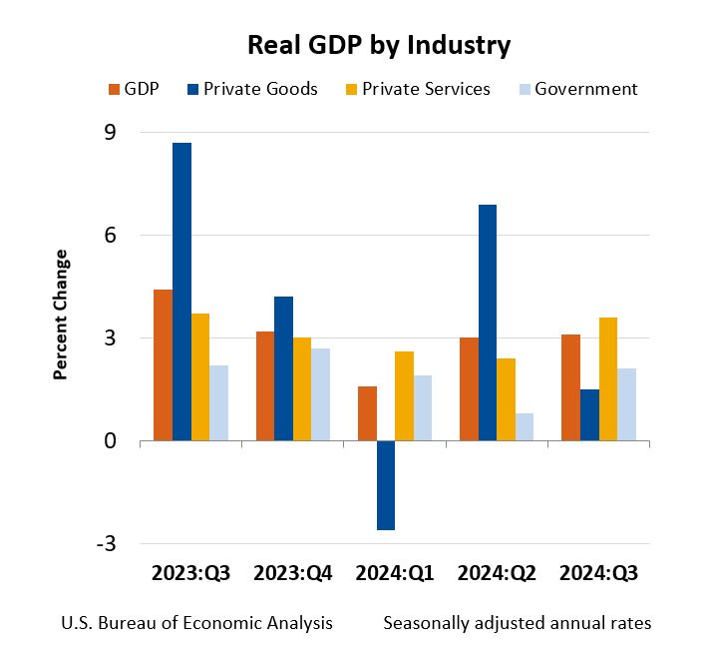
Components of Change in the 3rd quarter 2024

Slide 6


Latest Survey Report from the Federal Reserve Bank of New York on Household Consumption Expectations
Issued August 2024
Reported Spending Growth Moves Up in August 2024
“The median reported year-over-year increase in monthly nominal household spending moved up to 5.0 percent in August from 4.6 percent in April, according to the August SCE Household Spending Survey.”
“While slightly below its year-ago reading of 5.5 percent, the series remains well above pre-pandemic levels.”
“Median expected monthly overall spending growth over the next twelve months edged down 0.1 percent to 3.0 percent in August.”

Slide 7
Inflation Indices

Slide 8
CURRENT CONSUMER PRICE CHANGE
0.2% Increase in index from
November 2024 to December 2024
Year over Year
(December 2024 Data):
Overall, Seasonally Adjusted Change
(All Urban Consumers) = 2.9%

Slide 9
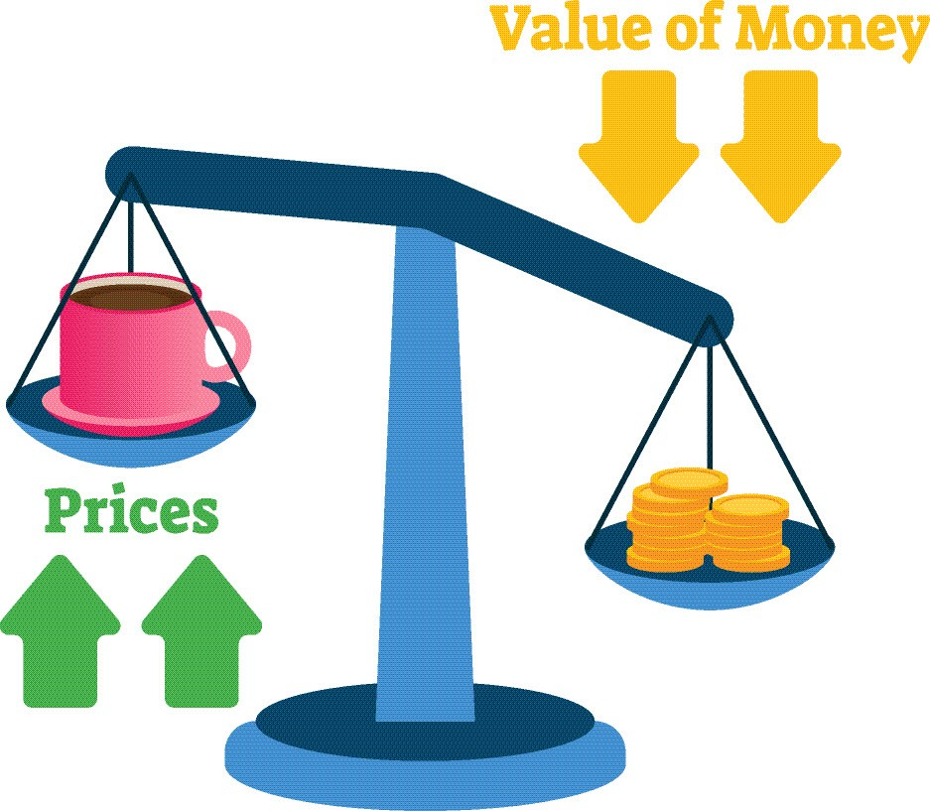

Slide 10

CPI Price Inflation:
(Non-Seasonally Adjusted Data)
Outside of Food at Home and Energy Prices Remain Sticky
December 2023 to December 2024
All Items: 2.9% Increase
  Food at Home: 1.8% Increase
  Food Away from Home: 3.6% Increase
  Energy Commodities: 3.9% Decrease
  Energy Services: 3.3% Increase
  Shelter: 4.6% Increase
  Medical Services: 3.4% Increase
  All Items Less Food and Energy: 3.2% Increase
Latest Total Compensation (Employer Costs per Hour Worked) Increase for all Civilian Workers over all Industries: (cost per hour worked)
December 2023 to December 2024
3.8% in current $

Slide 11
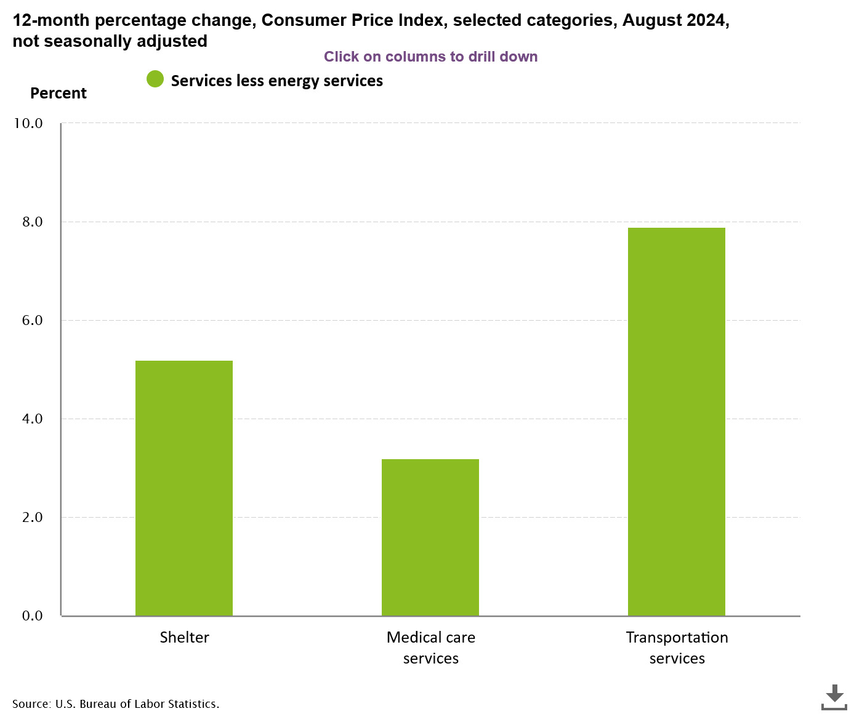
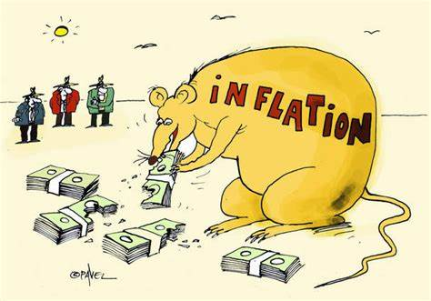

Slide 12
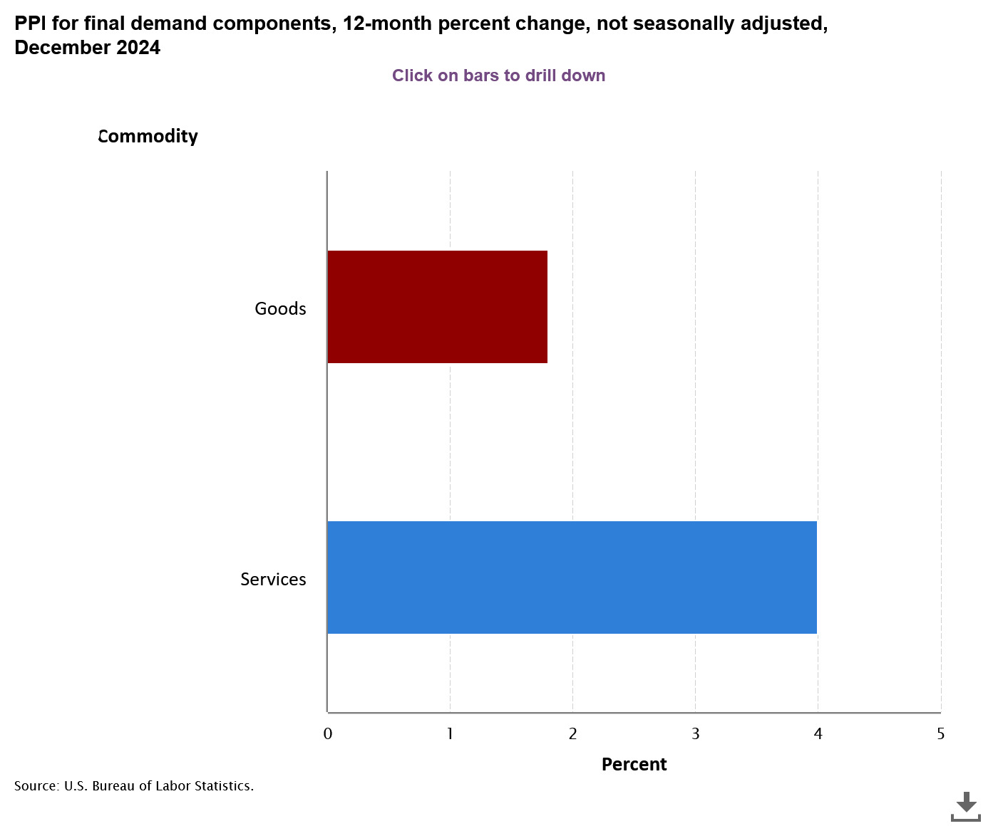
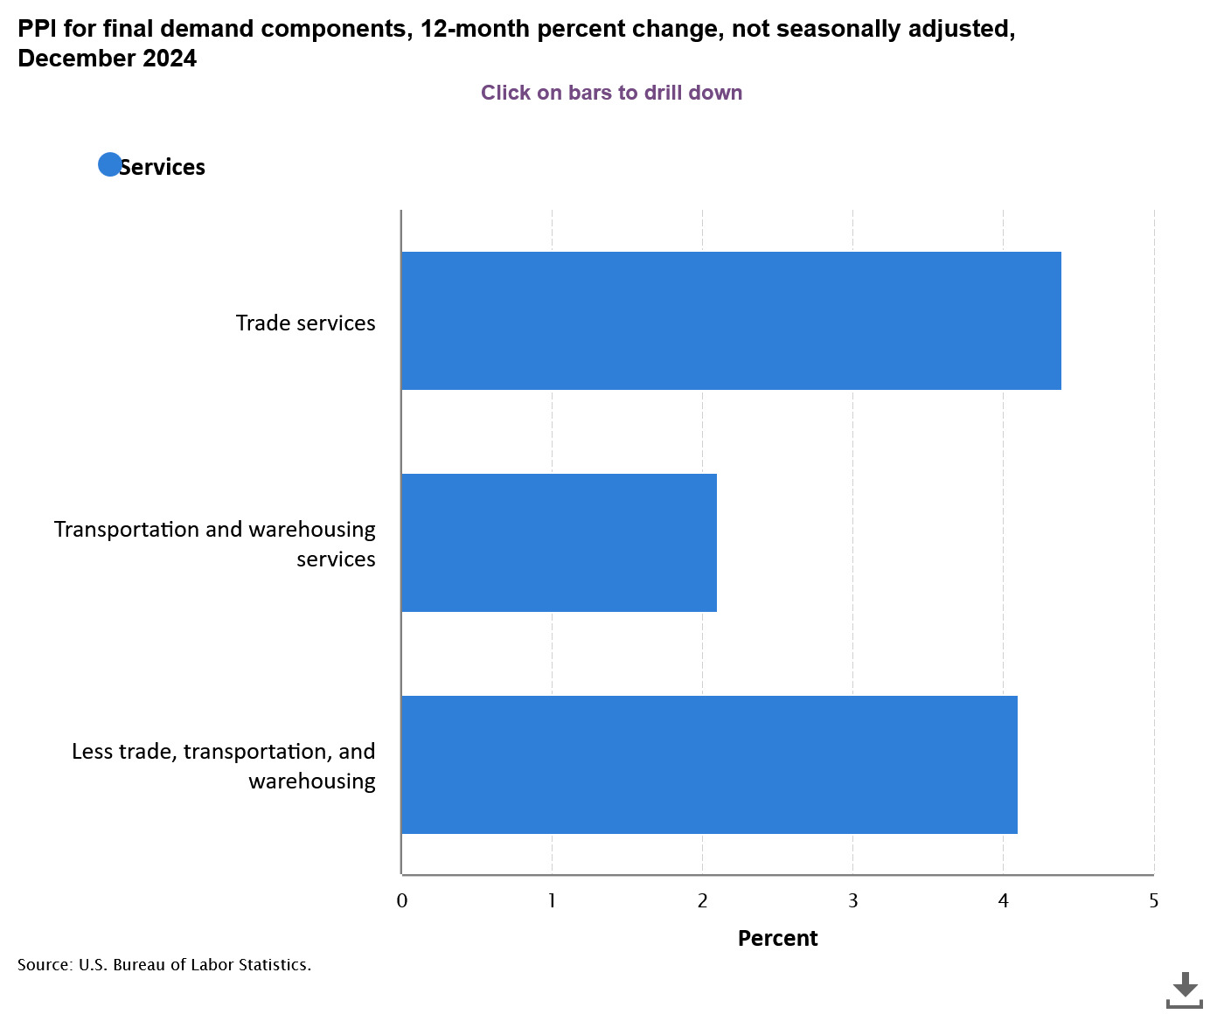
Producer Price Inflation Index:
Overall Change, all in a Positive Direction

Slide 13
PPI Index: Peaked in March 2022
NOTE: Total driven down mostly by fall in energy prices.
Services minus trade, transportation and warehousing remain stuck in the 4% to 4.8% range up to December 2024.
Recent BLS “Hires and Openings” data suggest employers continue cutting back on hires.
Producer Price Index Data up to December 2024
Wage, Salary and Benefits Data Up to September 2024

Slide 14

Wage Pressure Affecting General Price Inflation
Product Supply Conditions
Labor Force Growth

Slide 15
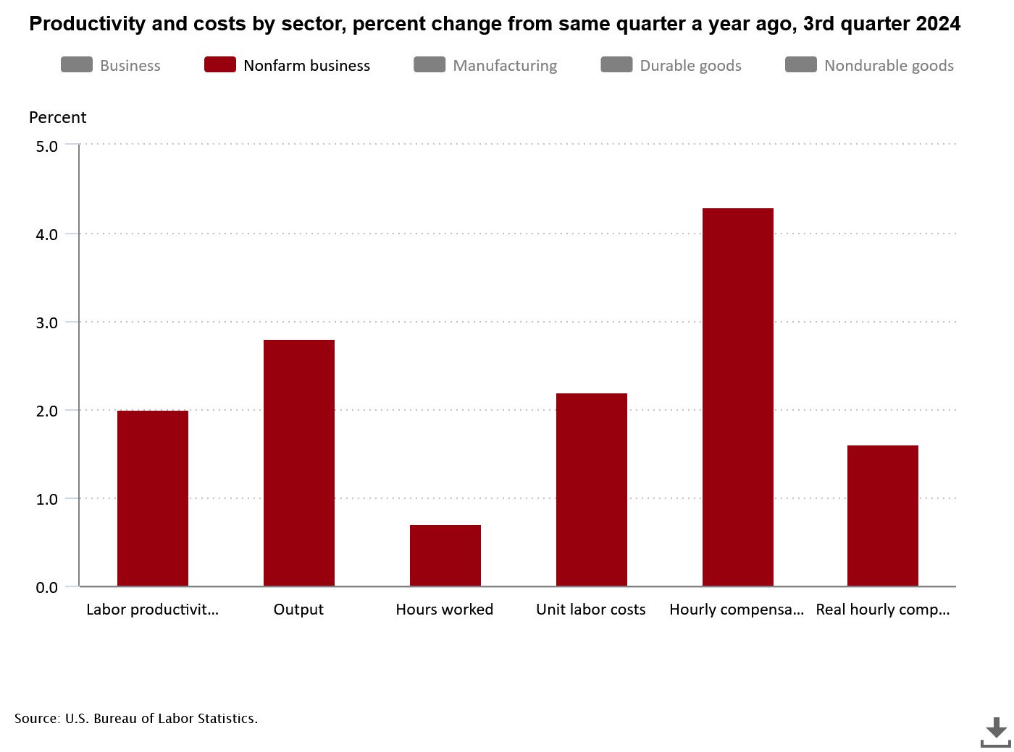
Inflation Built into system
Statistics reflect change from same quarter a year ago at annualized rate
4.3%
Nonfarm business sector labor productivity increased 2.0% percent in the 3rd quarter 2024 over the 3rd quarter 2023
Unit labor costs in the nonfarm sector increased by 2.2% in the 3rd quarter 2024 over previous year quarter.
Real average private hourly earnings increased by 1.5% from 3rd Quarter 2023 to 3rd Quarter 2024.
Source: Bureau of Labor Statistics
2.8%
2.0%
2.2%
1.5%
0.7%

Slide 16
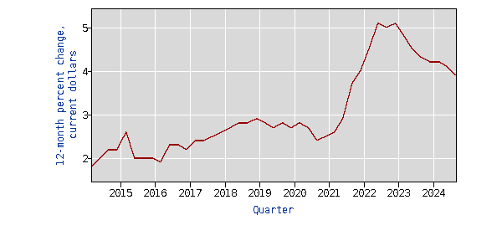
Total compensation
All Civilian workers in All industries and occupations, 12-month percent change
Inflationary Pressure:
Total Compensation:
3rd quarter 2024 = 3.9% year over year (2nd quarter 2023 to 2nd quarter 2024 was 4.1%)
Most Current Real Hourly Earnings (real earning increased by 1.0% between December 2023 and December 2024 (seasonally adjusted)
(Source: BLS)
TOTAL COMPENSATION FOR ALL CIVILIAN WORKERS IN ALL INDUSTRIES AND OCCUPATIONS,
12-MONTH PERCENT CHANGE in Current $
Source: Bureau of Labor Statistics

Slide 17
Weakening of Major Manufacturing and Service Industries Indices Pointing to a “potential” Stall in Growth

Slide 18
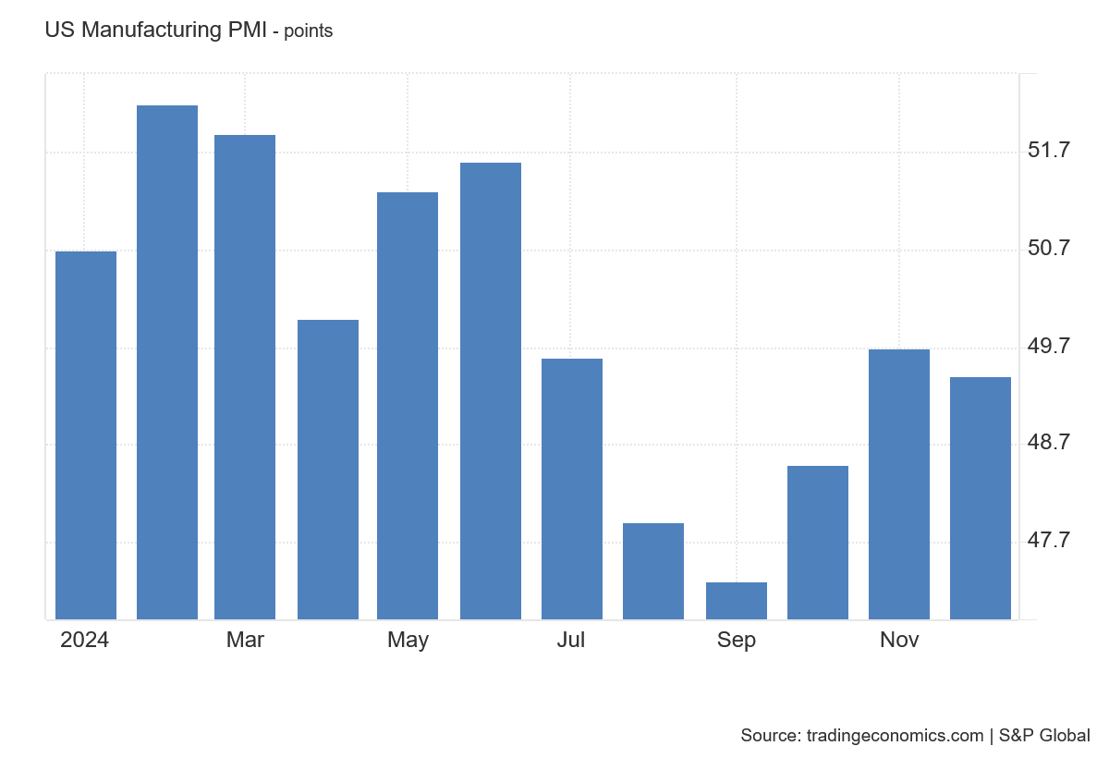
Manufacturing Purchasing Managers New Orders Index
Manufacturers Purchasing Managers New Orders Index (PMI) in December 2024 was 49.4
Source: tradingeconommics.com
A PMI reading above 50 percent indicates that the manufacturing economy is generally expanding; below 50 percent indicates that it is generally declining.

Slide 19
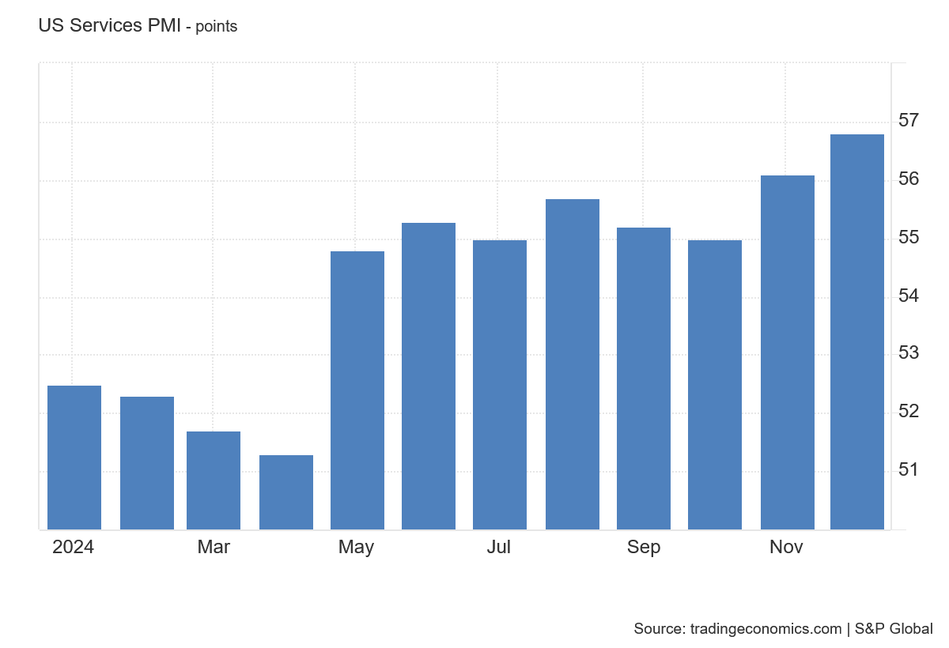
Strengthening Growth
To quote the “Trading Economics” Report:
“ The S&P Global US Services PMI was revised lower to 56.8 from 58.5 in December 2024 from 55.7, but was still above 56.1 in November and pointed to the strongest gain in the services sector since March 2022 ”
Source: Summary statistics. “Trading Economics”
Services Purchasing Managers Index (PMI)
Source: Trading Economics

Slide 20
Independent Data Still Finds Bottlenecks in Finding Skilled Labor

Slide 21
Openings per hires continue to Contract
Wage Pressure likely to Continue to decelerate
Openings per Hires continue to fall
However, Inflationary Pressures still well above historical levels.
Layoffs and discharges at historical low level, implying Reduction in labor turnover
Pointing to continued stress on prices from wage inflation.
As of November, there were 1.01 job openings for every unemployed (non-seasonally adjusted data)
Potential Consequences: rapid slowdown in hiring
Excess aggregate Labor downward pressure on wage increase

Slide 22
The Job and Labor Force Situation

Slide 23
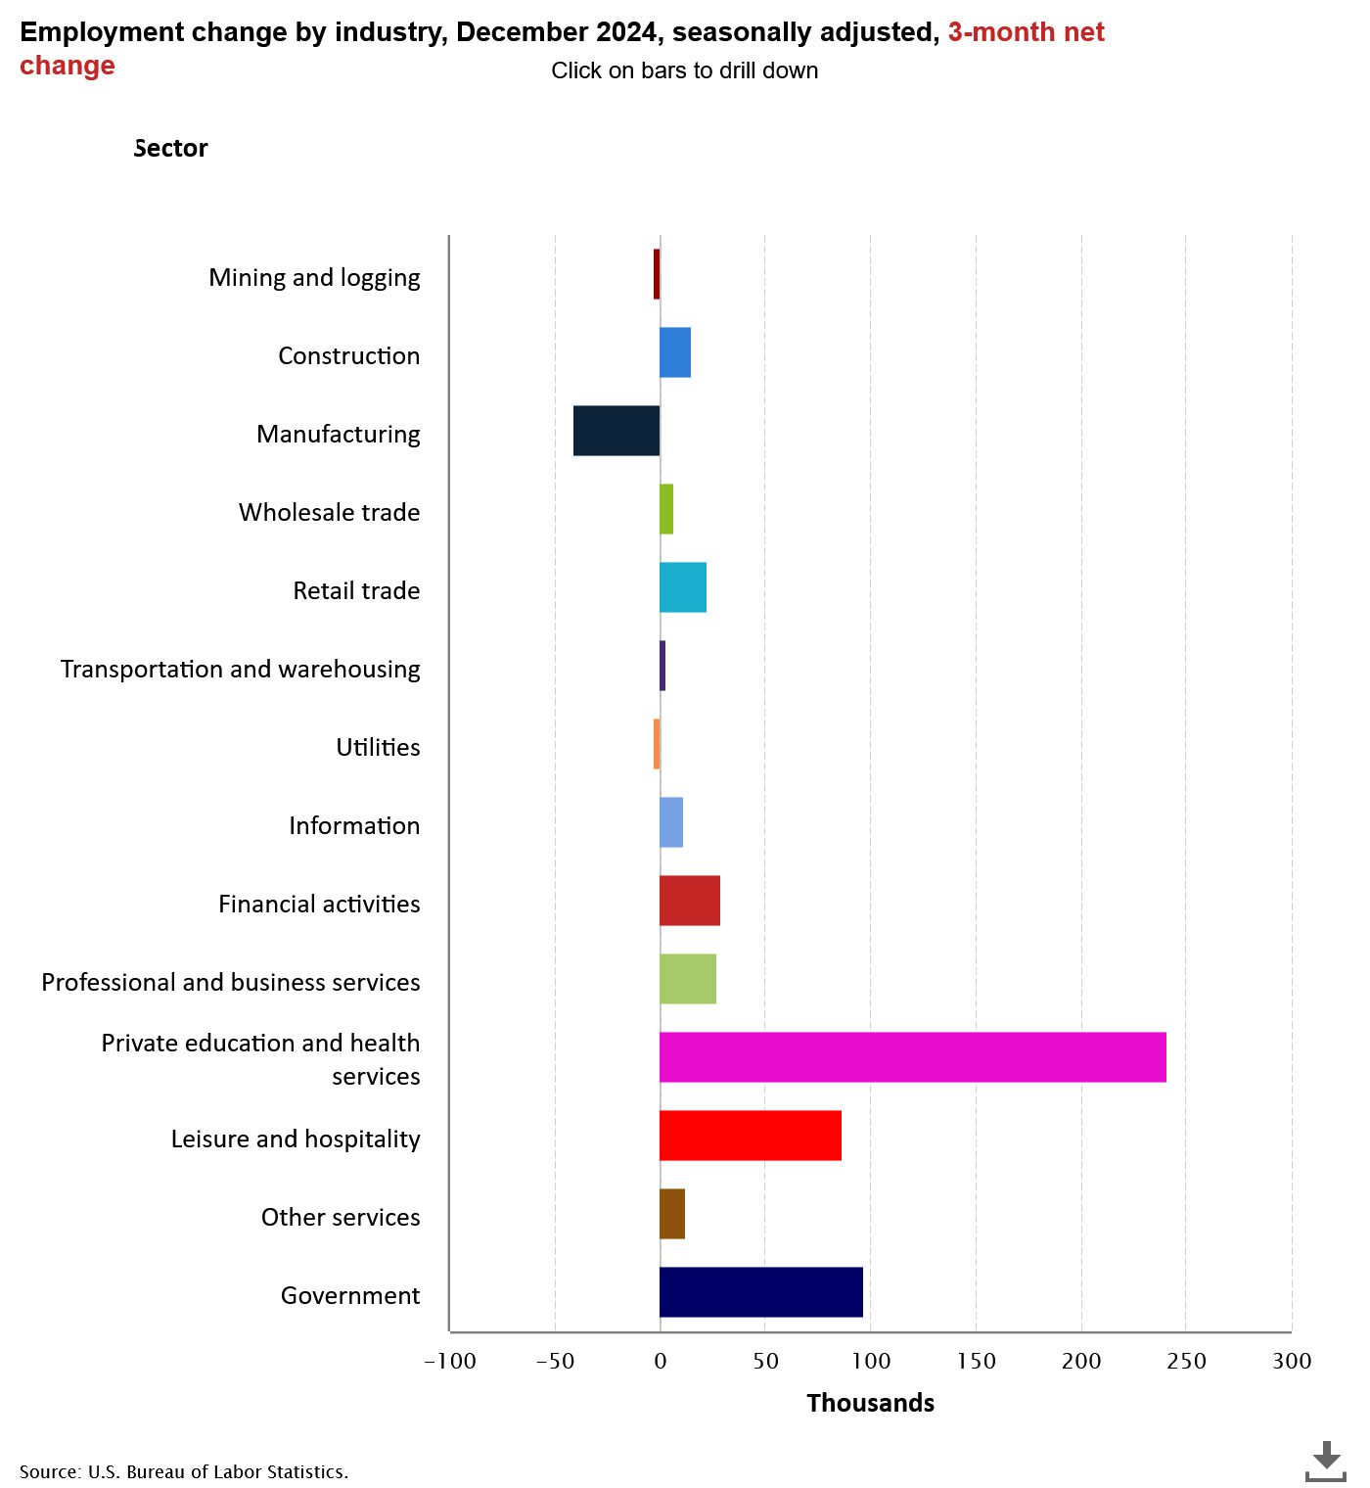
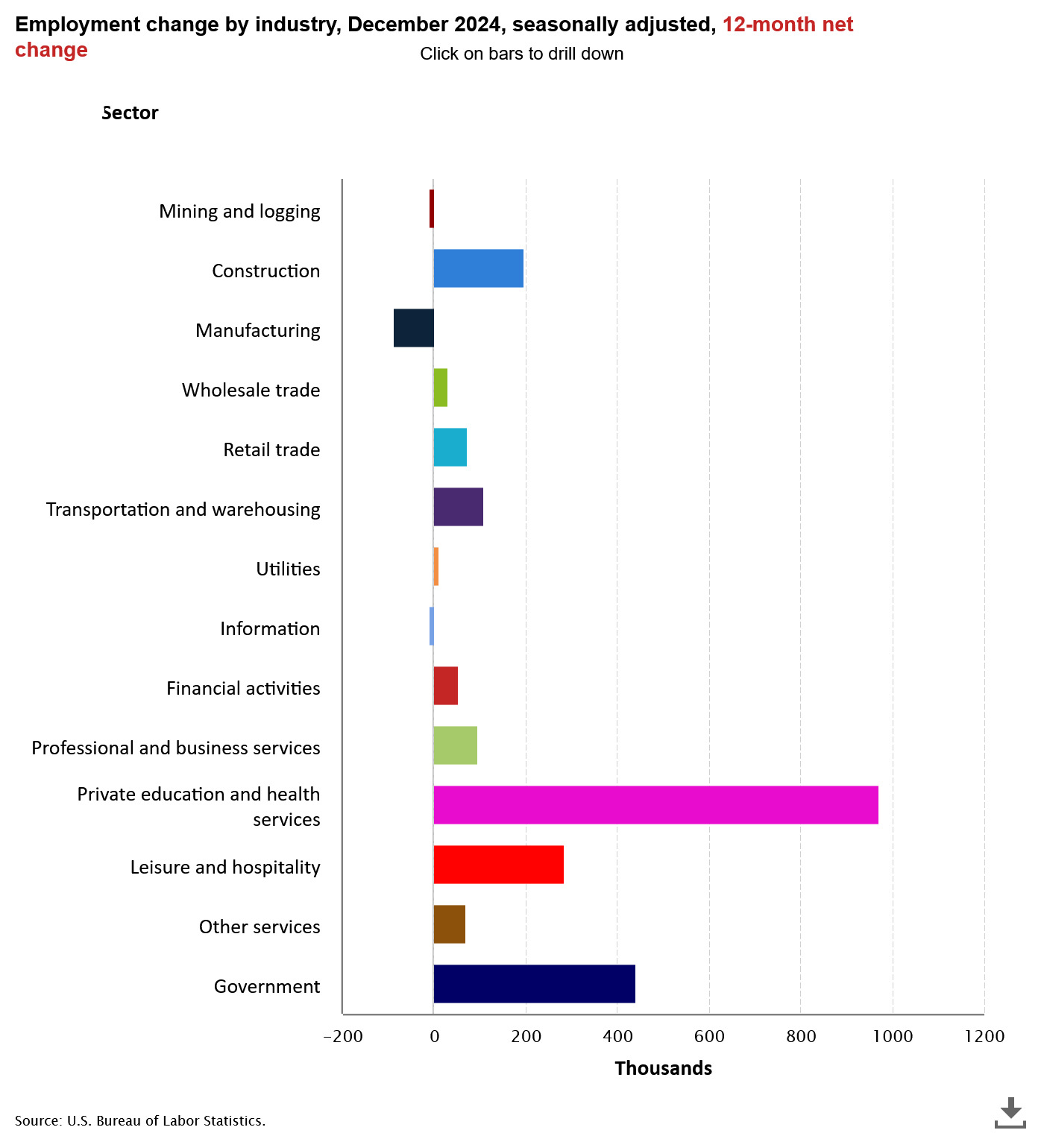
U.S. Employment Change Viewed
From A three-month and a twelve-month Change

Slide 24
Year 2008 indicates Participation Rate Pattern Change
Primary Causes…
Population aging, and Decline in the number of people who want to work
(source: National Bureau of Economic Research, “Declining Desire to work and Downward Trends in Unemployment and Participation,” Working Paper 21252, June 2015)

Slide 25
The Problem:
Stagnation (see above chart) in Labor force Growth likely limiting Potential Job Growth?
Adjusted for Price Inflation, long term Real Potential Personal Income Growth LESS than trend
116574.3
438.8672

Slide 26
A Closer Look At Accommodations and Food Services In Leisure and Hospitality
(Finally) Total U.S. (seasonally adjusted) Employment in Accommodations and Food Services was 71 thousand greater in December 2024 than the previous employment high point of December 2019 (14,336 million jobs). (Source: BLS)
1
Hence, it has taken nearly five years to recover to the previous historical high in jobs in Accommodation and Food Services (December 2019). (Source: BLS) seasonally adjusted
2
In Accommodations and Foods Service in November 2024:
Opening = 848 thousand jobs.
Hires =791 thousand
Layoffs= 205 thousand.
(all data are seasonally adjusted)
3

Slide 27
The National Unemployment Situation
Percent unemployed
Source: BLS Current Population Survey
Seasonally Adjusted
Month | Total | White | Black or African American | Asian | Hispanic or Latino
Dec 2021 | 3.9 | 3.3 | 7.0 | 3.8 | 4.8
Dec 2022 | 3.5 | 3.0 | 5.7 | 2.4 | 4.1
Jan 2023 | 3.4 | 3.1 | 5.4 | 2.8 | 4.5
September | 3.8 | 3.4 | 5.7 | 2.9 | 4.6
October | 3.8 | 3.5 | 5.8 | 3.1 | 4.8
November | 3.7 | 3.3 | 5.8 | 3.5 | 4.6
December | 3.7 | 3.5 | 5.2 | 3.1 | 5.0
Jan. 2024 | 3.7 | 3.4 | 5.3 | 2.9 | 5.0
June | 4.1 | 3.5 | 6.4 | 4.1 | 4.9
Dec.2024 | 4.1 | 3.6 | 6.1 | 3.5 | 5.1

Slide 28
A SNAPSHOT OF
CONSUMER BEHAVIOR
Source: BEA and Census Bureau

Slide 29
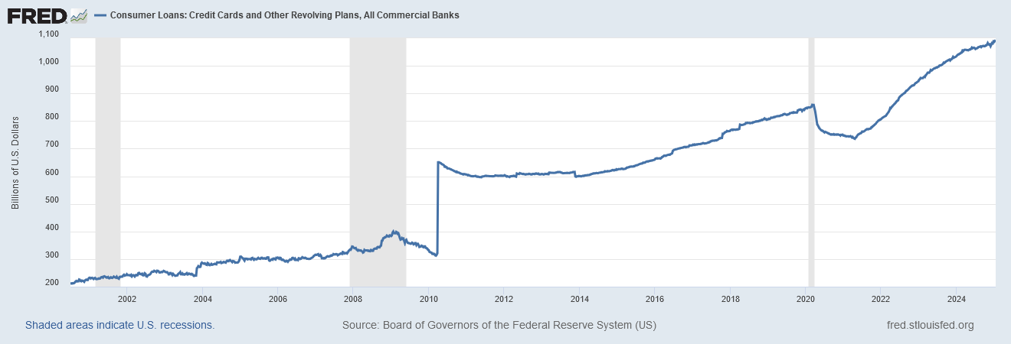
Loans, Credit Card and other Revolving Plans.
Savings Rate as a Percentage of Disposable Income Remains a Historical Low Level. (recall savings rate in “Summary of U.S.” Chart)
December 25,2024 Consumer Loans Debt Level = $1,088.7 billion

Slide 30
Thoughts on the National Outlook
Inflation Down… but creeping up
Budget Priorities and Distortions in the Marketplace
Background--International Instability

Slide 31
Current Louisiana Economic Outlook:
Key Words:
  “Repeat” Concern:
  Continued Weak Job Growth
  Relative to U.S.
  Personal Income Growth Driven by
  Dividends, Interest and Rent
  Transfer Payments and Health Care
  Key Uncertainty With Latest Modified Sales Tax Collection Schedule:
  Trend Flattens Over Time (historical data tends to support this concern)
  Sales Tax Collections Combined 1st thru 3rd Quarters for 2024 over 2023
  4.0% increase in current $
  Income Tax Collections between 1thru 3rd Quarters for 2024 over 2023
  7.2% increase in current $
  Major Long-Term Problems with Inflation Adjusted Labor Productivity, Output and
  Value-Added Per Worker Growth in Louisiana

Slide 32
Louisiana’s
Sales Tax Collections Slowing
Income Tax Collections Showing Weakness

Slide 35
The Fundamental Problem: Sustainability of Growth--
Stimulus Spending Drying Up, Inflation Eating Away at Consumption and Income

Slide 37
Data Shows: Louisiana Job Economy Significantly
Lagging U.S. Job Growth

Slide 38
The Reality: total number of CES non-farm jobs in Louisiana peaked (post-Hurricane Katrina) in December 2014 at 2.7% above the August 2005 level
December 2024 index reading = 100.8
August 2005 = 100

Slide 39
Source: Current Employment Survey, Bureau of Labor Statistics
STATE OF LOUISIANA |  | Total Non-Farm Employment December 2024
Non-Seasonally Adjusted Job Growth- December 2023 to December 2024
Health Care and Social Assistance | 8,200 | 295,300
Government | 7,500 | 329,600
All Others | 4,300 | 129,600
Private Educational Services | 3,900 | 52,700
Construction | 3,400 | 135,700
Professional and Business Services | 2,500 | 219,300
Wholesale Trade | 1,600 | 69,600
Support Activities in Transportation | 400 | 20,500
Information | 200 | 18,300
Truck Transportation | 0 | 17,300
Mining | -400 | 30,200
Retail Trade | -1,200 | 219,700
Manufacturing | -1,300 | 137,200
Financial Activities | -2,800 | 94,500
Leisure and Hospitality | -4,800 | 216,100
Total Change | 21,500 | 1,985,600

Slide 40
Louisiana Leisure and Hospitality Industry: little change in hours worked, Increase in Average Pay

Slide 41
Louisiana’s Personal Income Growth in 2024 Driven by Personal Transfer Payments

Slide 42
Personal Transfer Payments as A Percentage of Total Personal Income:
Louisiana’s Personal Income Level Highly Dependent of Transfer Payments
3RD Quarter 2024
Transfer Payments consist of:
  Social Security Benefits
  Medicare Benefits
  Medicare Benefits
  All Other transfer Benefits
Transfer Benefits as a percentage of total Personal Income
Louisiana = 24.6%
Alabama = 24.1%
South Carolina = 23.9%
California = 16.7%
  Louisiana Transfer Benefits for Medicaid highest among selected states
    Louisiana = 6.3% of Total PI
    Alabama = 2.8% of Total PI
    South Carolina = 3.3% of Total PI
    California = 4.5% of PI

Slide 43
Louisiana’s Personal
Income Growth
Source: Bureau of Economic Analysis
Millions of Current $
Personal Income Change For Select Components
4th Quarter 2019 to 3rd Quarter 2024
Personal income | $61,874
Earnings by place of work | $31,294
plus: Personal current transfer receipts | $20,768
Wage and salary disbursements | $23,573
Proprietors' income | $4,181
Nonfarm proprietors' income | $4,966
Farm earnings | -$639
Nonfarm earnings | $31,933
Private earnings | $27,951
Manufacturing | $2,516
Health and Social Assistance | $5,533
Construction | $3,298
Professional and Technical Services | $2,615
Arts, Entertainment and Recreation | $400
Accommodations and Food Services | $1,082
Mining and Oil and Gas Extraction | -$614

Slide 44
Louisiana
Description | 2019: Q1 | 2020:Q1 | 2022: Q3 | 2023:Q3 | 2024:Q3
Personal income (thousands of dollars, seasonally adjusted) Current $ | $220,909,368 | $221,684,120 | $252,336,499 | $257,772,714 | $269,974,972
Personal current transfer receipts (000) | $48,803,992 | $50,194,856 | $65,263,608 | $63,855,496 | $65,561,576
Social Security Benefits (000) | $14,228,824 | $14,543,116 | $15,039,348 | $16,284,300 | $18,098,144
Medicare benefits (000) | $12,212,512 | $12,259,136 | $13,569,944 | $14,307,032 | $15,567,748
Medicaid (000) | $11,822,336 | $12,071,120 | $14,235,840 | $15,533,492 | $17,013,108
State unemployment insurance compensation (000) | $173,992 | $593,264 | $1,684,872 | $113,180 | $154,760
All other personal current transfer receipts (000) | $10,366,328 | $10,728,220 | $20,733,604 | $17,617,492 | $14,727,816
Personal Current Transfers as a Fraction of Personal Income | 22.1% | 22.6% | 25.9% | 24.8% | 24.3%
Importance of Transfer Payments as a Fraction of PI
Personal Income Levels
Personal Transfer Payments
Other Transfer Payments
Note: Medicaid Growth
Source: Bureau of Economic Analysis

Slide 45
The Most Worrisome Problem
Structural Changes in Louisiana’s Economy have Created Long Term
Competitive Problems with
Labor Productivity
Output Per Worker
Value-Added and Wealth Creation
Full report found on gnodatacenter.com working paper #3

Slide 46
Definitions
Labor productivity - measures the hourly output of an economy. Specifically, it charts the amount of real gross domestic product (GDP) produced by an hour of labor. Growth in labor productivity depends on three main factors: saving and investment in physical capital, new technology, and human capital.
Output Per Worker- A measure of productivity calculated by dividing the total output by the number of workers.
Real value-added output - removing the effect of price level changes from the nominal value of a good, service, or time-series data, to obtain a truer picture of economic trends.

Slide 47
Louisiana’s Economy is Going Backwards in Key Areas
Year 2017= 100

Slide 48
Louisiana’s Economy is Going Backwards in Key Areas
Year 2017 = 100

Slide 49
Louisiana’s Economy is Going Backwards in Key Areas
Year 2017 = 100
99.0

Slide 51
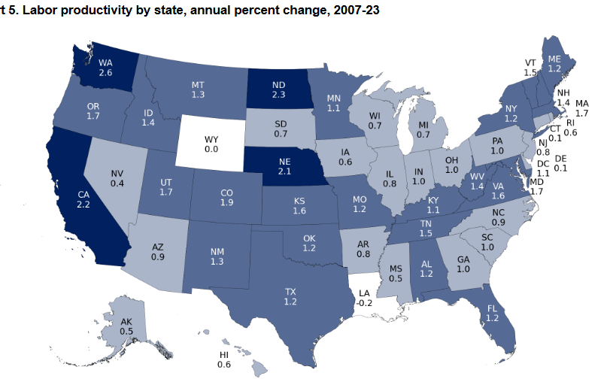
Source: Office of Productivity, Bureau of Labor Statistics

Slide 52
YOU CANNOT BUILD A STRONG ECONOMY
WITH THESE TYPE OF STATISTICS:
LOUISIANA IN ECONOMIC CRISIS:
Louisiana is Not Successfully Competing
Example: Louisiana vs South Carolina

Slide 53
 | State Gross Domestic Product Growth in Inflation Adjusted $ ( Millions of Chained 2017 $)
 | % CHANGE |  | REAL GDP (IN BILLIONS) CHANGE
Industry | 2012-2023 |  | 2012-2023
 | Louisiana | South Carolina | Louisiana | South Carolina
Mining | -28.3% | 242.1% | -$3,663 | $489
Manufacturing | -20.5% | 14.3% | -$9,413 | $5,925
Wholesale Trade | -5.3% | 33.1% | -$647 | $4,339
Retail Trade | 17.6% | 51.4% | $2,525 | $3,168
Information | 29.9% | 132.0% | $1,217 | $6,760
Professional and Business Services | 17.7% | 60.4% | $3,538 | $9,319
Healthcare and Social Assistance | 39.8% | 52.1% | $6,333 | $3,866
Leisure and Hospitality | 4.7% | 40.2% | $476 | $1,846

Slide 54
Percentage Change in Real Output Per Worker Over Time
 | Change 2007- 2023 | Change 2007-2012 | Change 2012-2023
Alabama | 97.0% | 18.9% | 65.7%
Arkansas | 106.1% | 17.6% | 75.3%
Florida | 142.9% | 3.0% | 135.9%
Georgia | 120.3% | 11.2% | 98.2%
Louisiana | 47.1% | 16.7% | 26.1%
Mississippi | 68.7% | 21.7% | 38.7%
North Carolina | 120.3% | 15.4% | 90.8%
South Carolina | 121.4% | 14.1% | 94.1%
Tennessee | 164.2% | 27.0% | 108.0%
Texas | 150.6% | 26.0% | 98.9%
Virginia | 124.7% | 21.2% | 85.4%
South | 129.1% | 19.4% | 91.8%
Source: Office of Productivity and Technology, Bureau of Labor Statistics

Slide 55
Percentage Increase in Value-Added per Worker in Gross State Product
2007 - 2023
Current $
Value-added Per Worker Increase
in State Gross Product
2007 – 2023
Current $
Tennessee | 83.2%
Virginia | 69.3%
Florida | 68.9%
Alabama | 65.7%
South | 64.9%
North Carolina | 64.4%
Arkansas | 64.3%
South Carolina | 64.1%
Georgia | 61.9%
Mississippi | 59.1%
Texas | 57.4%
Louisiana | 46.9%
Tennessee | $63,497
Texas | $60,491
Virginia | $59,177
South | $56,575
Florida | $55,723
Georgia | $55,444
North Carolina | $53,178
Alabama | $48,064
South Carolina | $45,765
Louisiana | $45,606
Arkansas | $45,188
Mississippi | $40,117
Source: Annual Labor Productivity by State, Bureau of Labor Statistics (May 2024)
Calculated Percentage Change and Growth in Value-Added Per Worker by Systems Solutions Consulting

Slide 56
Example of the Problem: Labor Productivity Index
OVER the 2007 to 2023 period by State
Average % Change in the Index Over 2007-2023
Virginia | 1.6
Tennessee | 1.4
Georgia | 1.2
South | 1.1
South Carolina | 1.0
Florida | 1.0
Alabama | 1.0
North Carolina | 0.9
Texas | 0.9
Arkansas | 0.8
Mississippi | 0.5
Louisiana | -0.6
Median % Change of Labor Productivity Index Over 2007 to 2023
Tennessee | 1.8
Georgia | 1.5
North Carolina | 1.2
Texas | 1.2
Virginia | 1.2
Alabama | 0.7
Florida | 0.7
South | 0.7
South Carolina | 0.6
Arkansas | 0.3
Louisiana | 0.1
Mississippi | -0.2
The Problem for Louisiana:
Average Annual Change in the Productivity index over the 2007 to 2023 period was -0.06%
Half of the annual change in the index was above 0.1% or below 0.1%

Slide 57
Unit Labor Costs Increase between 2012and 2023 by Select State
Source: office of Technology and Productivity, Bureau of Labor Statistics
Louisiana | 63.6%
Florida | 46.2%
Mississippi | 44.5%
North Carolina | 44.2%
South Carolina | 42.4%
Texas | 40.7%
Alabama | 40.5%
South | 39.0%
Arkansas | 37.6%
Georgia | 36.4%
Virginia | 29.6%
Unit Labor Cost Defined- Ratio of labor compensation per hour divided by product output per hour expressed in current dollars. Compensation/output = unit labor cost

Slide 58
Unit Labor Cost: Another Element of the Economic Crisis
Unit labor Cost is not a problem as long a productivity rises commensurate to increase in labor costs
In Louisiana’s case, the data shows otherwise

Slide 59
New Orleans MSA Outlook: An Economy in Trouble
Key Words:
MSA Job and Wealth Creation Economy Faltering:
Professional and Technical Services:
Starting to Stagnate
Less and Less Industry Diversity and
Occupational Diversity
MSA Population Growth Continues it Downward Spiral
and Particularly Orleans Parish

Slide 60
Latest data shows New Orleans MSA private sector job growth is stagnating.
Current Employment Survey jobs still down by 16,000 private sector jobs in December 2024 compared to February 2020 pre-Covid job level.
Data Includes St. Tammany Parish

Slide 63
New Orleans Metropolitan Statistical Area |  | Total Non-Farm Jobs | Total Non-Farm Jobs August 2005
Non-Farm Non-Seasonally Adjusted Jobs
December 2023 to December 2024 |  | December 2024
Private Educational Services | 2,000 | 33,300 | 18,800
All Government | 1,600 | 71,900 | 103,900
All Others | 1,600 | 25,800 | 23,600
Transportation, Warehousing & Utilities | 1,500 | 31,200 | 28,000
Professional and Business Services | 1,300 | 75,600 | 74,300
Health Care and Social Assistance | 1,200 | 77,300 | 62,200
Wholesale Trade | 500 | 22,500 | 26,300
Information | 300 | 6,900 | 10,500
Mining | 0 | 3,200 | 8,500
Construction | 0 | 27,500 | 30,100
Manufacturing | -300 | 29,900 | 41,500
Financial Activities | -500 | 29,200 | 33,300
Retail Trade | -1,400 | 57,800 | 67,500
Leisure and Hospitality | -1,500 | 79,800 | 86,000
Total Change | 6,300 | 571,900 | 614,500
Source: Bureau of Labor Statistics

Slide 64
GDP Measured in Inflation Adjusted $ for the New Orleans MSA:
Value of Aggregate $ output Reflects
Greater Reliance on Industries Producing Lower Value output

Slide 65
Current Job Levels for Jefferson, Orleans
and St. Tammany Parishes
Source: Quarterly Census of Employment and Wages
Bureau of Labor Statistics

Slide 67
Key Parish Job Levels
Source: Quarterly Census of Employment and Wages, Bureau of Labor Statistics, Actual Data, January 2007- September 2024, Model Estimates, October to December 2024, Systems Solutions Consulting

Slide 68
Key Parish Job Levels
Source: Quarterly Census of Employment and Wages, Bureau of Labor Statistics, Actual Data, January 2007- September 2024 Model Estimates, October 2024 to December 2024, Systems Solutions Consulting
St. Tammany QCEW job level in September 2022 had recovered all pre-Covid 19 lock-down jobs. December 2024 estimated job level was 6,600 greater than the pre-Covid February 2020 level.
Orleans Parish, as of December 2024, was still down by 15,400 QCEW jobs below the pre-Covid February 2020 level.
Jefferson Parish, as of December 2024, was down by 5,500 QCEW jobs below the pre-Covid February 2020 Level.
December 2024
QCEW = 97,000 jobs

Slide 69
Population Levels Labor Market Area 1
Source: U.S. Census Bureau
And Systems Solutions Consulting

Slide 70
 |  | Louisiana | Jefferson | Orleans | Plaquemines | St. Bernard | St. Charles | St. James | St. John | St. Tammany | Labor Market 1
Census | 1900 | 1,384,100 | 15,321 | 287,104 | 13,039 | 5,031 | 9,072 | 20,197 | 12,330 | 13,335 | 375,429
 | 1910 | 1,667,000 | 18,247 | 339,075 | 12,524 | 5,277 | 11,207 | 23,009 | 14,338 | 18,917 | 442,594
 | 1920 | 1,813,000 | 21,563 | 387,219 | 10,194 | 4,968 | 8,586 | 21,228 | 11,896 | 20,645 | 486,299
 | 1930 | 2,105,000 | 40,032 | 458,762 | 9,608 | 6,512 | 12,111 | 15,338 | 14,078 | 20,929 | 577,370
 | 1940 | 2,370,000 | 50,427 | 494,537 | 12,318 | 7,280 | 12,321 | 16,596 | 14,766 | 23,624 | 631,869
 | 1950 | 2,697,000 | 103,873 | 570,445 | 14,239 | 11,087 | 13,363 | 15,334 | 14,861 | 26,988 | 770,190
 | 1960 | 3,260,000 | 208,769 | 627,525 | 22,545 | 32,186 | 21,219 | 18,369 | 18,439 | 38,643 | 987,695
 | 1970 | 3,644,637 | 337,568 | 593,471 | 25,225 | 51,185 | 29,550 | 19,733 | 23,813 | 63,585 | 1,144,130
 | 1980 | 4,223,101 | 454,592 | 557,515 | 26,049 | 64,097 | 37,259 | 21,495 | 31,924 | 110,869 | 1,303,800
 | 1990 | 4,219,973 | 448,306 | 496,938 | 25,575 | 66,631 | 42,437 | 20,879 | 39,996 | 144,508 | 1,285,270
 | 2000 | 4,468,886 | 455,466 | 484,674 | 26,757 | 67,229 | 48,072 | 21,216 | 43,044 | 191,268 | 1,337,726
Census Estimates | 1-Jul-01 | 4,477,875 | 453,154 | 487,363 | 27,029 | 68,028 | 48,461 | 21,291 | 43,580 | 195,622 | 1,344,528
 | 1-Jul-02 | 4,497,267 | 453,429 | 489,722 | 27,462 | 68,964 | 49,117 | 21,365 | 43,878 | 200,701 | 1,354,638
 | 1-Jul-03 | 4,521,042 | 454,533 | 492,187 | 28,169 | 69,621 | 49,338 | 21,274 | 44,316 | 205,708 | 1,365,146
 | 1-Jul-04 | 4,552,238 | 456,602 | 493,765 | 29,390 | 70,547 | 49,939 | 21,229 | 44,822 | 211,405 | 1,377,699
 | 1-Jul-05 | 4,576,628 | 456,554 | 494,294 | 29,558 | 71,300 | 50,670 | 21,399 | 45,296 | 217,358 | 1,386,429
 | 1-Jul-06 | 4,302,665 | 426,285 | 230,172 | 22,329 | 16,563 | 52,453 | 21,964 | 47,296 | 223,133 | 1,040,195
 | 1-Jul-07 | 4,375,581 | 432,683 | 268,751 | 22,709 | 23,613 | 52,765 | 22,164 | 47,386 | 226,294 | 1,096,365
 | 1-Jul-08 | 4,435,586 | 431,759 | 301,842 | 22,677 | 28,879 | 52,516 | 22,095 | 46,811 | 229,252 | 1,135,831
 | 1-Jul-09 | 4,491,648 | 431,921 | 327,803 | 22,730 | 32,878 | 52,719 | 22,231 | 46,336 | 231,224 | 1,167,842
Census | 2010 | 4,533,372 | 432,552 | 343,829 | 23,042 | 35,897 | 52,780 | 22,102 | 45,924 | 233,740 | 1,189,866
Census Estimates | 1-Jul-10 | 4,544,996 | 432,755 | 347,903 | 23,123 | 36,813 | 52,844 | 22,006 | 45,624 | 234,568 | 1,195,636
 | 1-Jul-11 | 4,575,625 | 434,089 | 360,735 | 23,582 | 39,516 | 52,390 | 21,784 | 45,066 | 236,846 | 1,214,008
 | 1-Jul-12 | 4,600,972 | 433,954 | 369,787 | 23,826 | 41,483 | 52,420 | 21,634 | 44,719 | 239,064 | 1,226,887
 | 1-Jul-13 | 4,624,527 | 434,264 | 378,637 | 23,509 | 43,430 | 52,614 | 21,607 | 43,570 | 241,953 | 1,239,584
 | 1-Jul-14 | 4,644,013 | 434,078 | 383,940 | 23,304 | 44,439 | 52,678 | 21,515 | 43,714 | 245,237 | 1,248,905
 | 1-Jul-15 | 4,664,628 | 435,175 | 389,742 | 23,437 | 45,421 | 52,572 | 21,481 | 43,523 | 248,930 | 1,260,281
 | 1-Jul-16 | 4,678,135 | 436,572 | 391,843 | 23,323 | 45,777 | 52,796 | 21,433 | 43,401 | 252,468 | 1,267,613
 | 1-Jul-17 | 4,670,560 | 436,126 | 391,493 | 23,348 | 46,110 | 52,620 | 21,380 | 43,328 | 255,921 | 1,270,326
 | 1-Jul-18 | 4,659,690 | 433,884 | 391,004 | 23,385 | 46,780 | 52,775 | 21,151 | 43,119 | 258,035 | 1,270,133
 | 1-Jul-19 | 4,648,794 | 432,493 | 390,144 | 23,197 | 47,244 | 53,100 | 21,096 | 42,837 | 260,419 | 1,270,530
Census | 2020 | 4,657,757 | 440,781 | 383,997 | 23,515 | 43,764 | 52,549 | 20,192 | 42,477 | 264,570 | 1,271,845
Estimates | 1-Jul-20 | 4,652,022 | 439,725 | 383,241 | 23,460 | 43,856 | 52,513 | 20,120 | 42,366 | 265,000 | 1,270,281
 | 1-Jul-21 | 4,627,047 | 434,134 | 377,346 | 23,310 | 44,324 | 52,470 | 19,794 | 42,109 | 270,147 | 1,263,634
 | 1-Jul-22 | 4,588,023 | 426,030 | 369,917 | 22,618 | 44,419 | 51,058 | 19,388 | 39,955 | 273,237 | 1,246,622
 | 1-Jul-23 | 4,573,749 | 421,777 | 364,136 | 22,386 | 44,463 | 50,620 | 19,191 | 39,592 | 275,583 | 1,237,748
 | Source: U.S. Census Bureau; Systems Solutions Consulting

Slide 71
Multiple Sources and Notes: Years 1920, 1930, 1960, 2000, 2010 and 2020 are April 1 actual U.S. Census data counts. Years 2011-2019 reflect July 1 estimates of the U.S. Census Bureau. Years 2015 to 2019 of the 2011 to 2019 data series reflect adjustments made by Systems Solutions Consulting to Census Bureau estimates to reflect the population trend toward 2020 U.S. Census Bureau April 1 actual population count. The years 2021-2023 reflect the continuation of July 1 Census estimates. The years 2024 and 2025 reflect Systems Solutions regression model estimate. Specifically, the population estimate is for January 2025. Current Census time series data covers the period 2006 to 2023. The Census model was updated in March 2024 with the inclusion of July 2023 data from the U.S. Census Bureau. All data estimates from the Systems Solutions model for the non-Census Bureau data years are based upon monthly postal survey data as one input. Postal survey data are gathered from “The Data Center-New Orleans” web site https://www.datacenterresearch.org
Note on errors: The Systems Solutions model estimated July 2023 New Orleans population total population at 368,176. The Census Bureau estimate for July 2023 was a population of 364,136. Hence, the model difference was 4,040 higher than the Census Bureau estimate or 1.1% difference.

Slide 72
Summary
  NATIONAL ECONOMIC PICTURE
  PRICE INFLATION STILL “STICKY”… Trend is downward…Wage-Price Inflation May Upset the “APPLE CART”
  LACK OF CLARITY ON INTEREST RATE DIRECTION
  INTERNATIONAL INSTABILITY-- MAJOR BACKGROUND PROBLEM TO MODERATING INFLATION
  LOUISIANA JOB RECOVERY: SLOW TO STAGNANT
    STATE REVENUE GROWTH SUBSTANTIALLY SLOWING
    PREVIOUS GROWTH DISGUISED STRUCTURAL WEAKNESS IN STATE ECONOMY
    DATA SUGGESTS MAJOR ISSUES WITH PRODUCTIVITY, OUTPUT PER WORKER AND VALUE-ADDED
  NEW ORLEANS MSA ECONOMY RECOVERY: WEAK AND GETTING WEAKER: LOTS OF UNDERLYING ISSUES
    LEISURE AND HOSPITALITY RESTRUCTURING? … IMPACT ON LABOR DEMAND
    TECHNICAL AND SCIENTIFIC SERVICES JOB GROWTH BOTTOM FALLING OUT
    POVERTY AND CRIME…
    POPULATION GROWTH CONTINUES STAGNATION PATH
    CENSUS BUREAU HAS REDEFINED NEW ORLEANS MSA AREA: ST.TAMMANY PARISH REMOVED RESULTING IN NEW ORLEANS MSA POPULATION FALLING TO LESS THAN ONE MILLION POPULATION

