Slide 1
October 2024 Economic Overview www. GNODATACENTER.COM
CURRENT ASSESSMENT OF U.S., LOUISIANA, NEW ORLEANS MSA and CITY OF NEW ORLEANS
Prepared By
Dr. Raymond J. Brady
Systems SOLUTIONS
CONSULTING

Slide 2
October Update of the
U.S. 2024 Economic Outlook:
Key Words:
Inflation Rate Down, Is it a Trend or ?
Debt: No discussion on Managing
Consumer Spending Holding Up Because of a Mountain of Debt
Data: The Rear-View Mirror Problem

Slide 3
Annualized
Real GDP 2nd Quarter 2024 (3rd estimate) | 3.0%
Current-Dollar (annualized) | 5.6%
Real GDP 2nd Quarter 2023 (Final Estimate) | 2.1%
Current-Dollars (annualized) | 4.1%
Source: Bureau of Economic Analysis
PCE Price Index (Change from Month Previous Year)
August 2024 | 2.2%
July 2024 | 2.5%
June 2024 | 2.4%
May 2024 | 2.6%
January 2024 | 2.4%
Source: Bureau of Economic Analysis
Percentage Change Seasonally Adjusted Expenditures in Food and Drinking Places
August 2019-August 2018 | 4.3%
August 2023-August 2022 | 9.4%
August 2024-August 2023 | 3.8%
Source: Federal Reserve Bank of St. Louis (current adjusted $)
Personal Savings as a % of Disposable Income (Seasonally Adjusted at Annual Rates)
August 2024 | 4.8%
August 2023 | 4.7%
August 2019 | 6.9%
Source: Bureau of Economic Analysis
SUMMARY OF
U.S. DATA

Slide 4
What does the 2nd quarter 2024 U.S. GDP 3rd Estimate Tell Us.
To quote the BEA Data Release: “Compared to the first quarter, the acceleration in real GDP in the second quarterly primarily reflected an upturn in private inventory investment and an acceleration in consumer spending. These movements were partly offset by a downturn in residential fixed investment.”
Real Gross Domestic Product increased by an annualized rate of 3.0%, revised up from 2.8%
According to the BEA news release “the increase in real GDP primarily reflected increases in consumer spending, private inventory investment, and nonresidential fixed investment.”

Slide 5
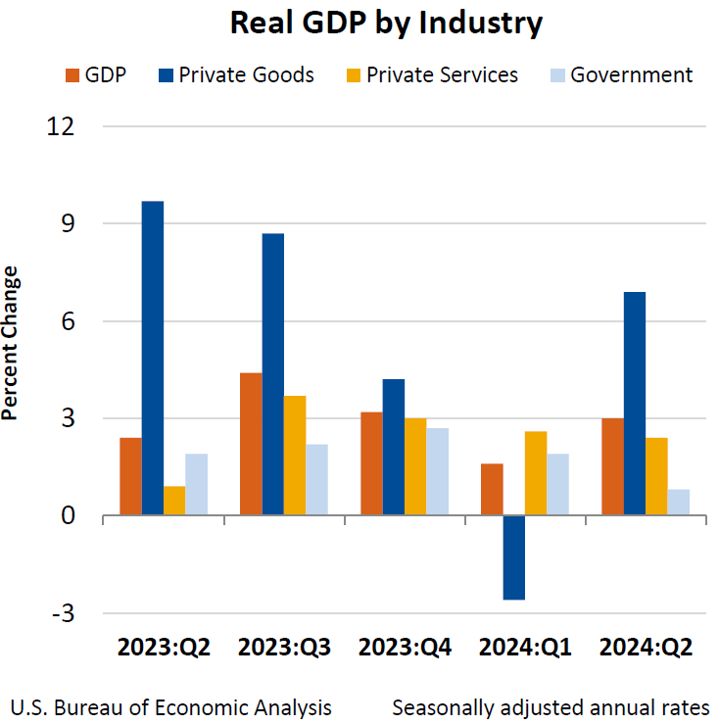
Components of Change in the 2nd quarter 2024

Slide 6
Latest Survey Report from the Federal Reserve Bank of New York on Household Consumption Expectations Issued August 2024
Reported Spending Growth Moves Up in August
“The median reported year-over-year increase in monthly nominal household spending moved up to 5.0 percent in August from 4.6 percent in April, according to the August SCE Household Spending Survey.”
“While slightly below its year-ago reading of 5.5 percent, the series remains well above pre-pandemic levels.”
“Median expected monthly overall spending growth over the next twelve months edged down 0.1 percent to 3.0 percent in August.”

Slide 7
Inflation Indices

Slide 8
CURRENT CONSUMER PRICE CHANGE 0.3% Decrease in index from July 2024 to August 2024 Year over Year (August 2024 Data): Overall, Seasonally Adjusted Change (All Urban Consumers) = 2.6%

Slide 9
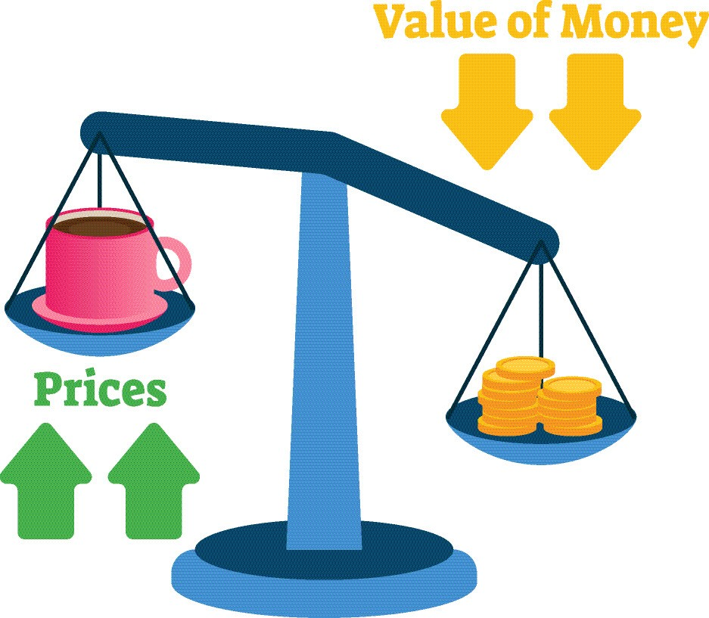

Slide 10
CPI Price Inflation: (Non-Seasonally Adjusted Data)
Outside of Food at Home and Energy Prices Remain Sticky
August 2024 over August 2023
All Items: 2.5% Increase
Food at Home: 0.9% Increase
Food Away from Home: 4.0% Increase
Energy Commodities: 10.1% Decrease
Energy Services: 3.1% Increase
Shelter: 5.2% Increase
Medical Services: 3.2% Increase
All Items Less Food and Energy: 3.2% Increase
Latest Total Compensation (Employer Costs per Hour Worked) Increase for all Civilian Workers over all Industries: (cost per hour worked)
2nd quarter 2023 to 2nd quarter 2024
6.8% in current $

Slide 11
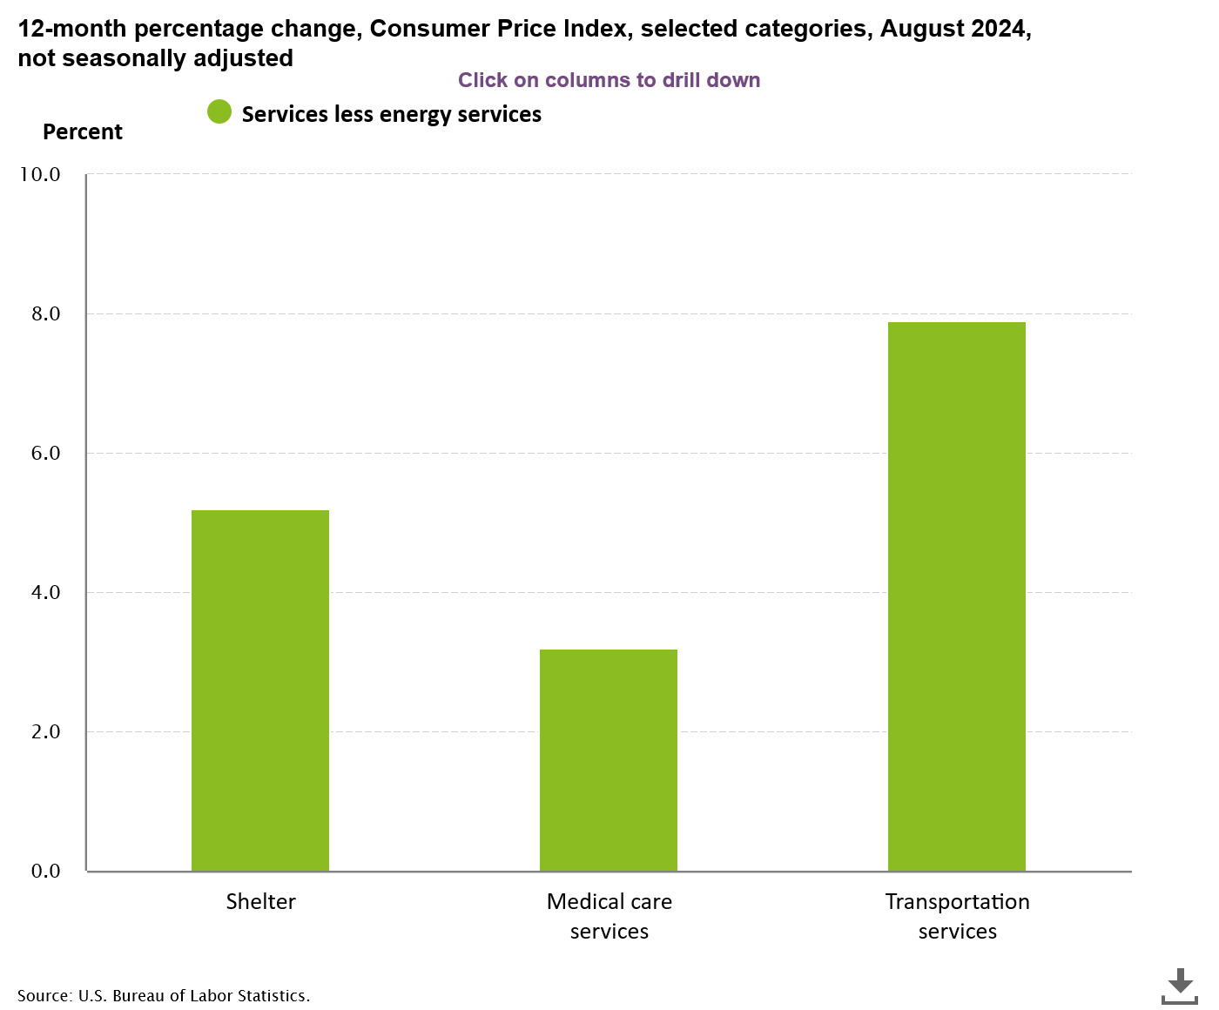

Slide 12
Producer Price Inflation Index:
Overall Change, all in a Positive Direction

Slide 13
PPI Index: Peaked in March 2022
NOTE: Total driven down mostly by fall in energy prices.
Services minus trade, transportation and warehousing remain stuck in the 4% to 4.8% range up to August 2024.
Recent BLS “Hires and Openings” data suggest employers continue cutting back on hires.
Producer Price Index Data up to August 2024
Wage, Salary and Benefits Data Up to June 2024

Slide 14
Wage Pressure Affecting General Price Inflation
Product Supply Conditions
Labor Force Growth

Slide 15
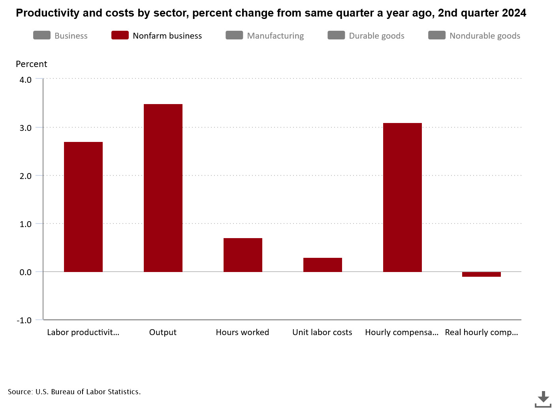
Inflation Built into system Statistics reflect change from same quarter a year ago at annualized rate
3.5%
Nonfarm business sector labor productivity increased 2.7% percent in the 2nd quarter 2024 over the 2nd quarter 2023
Unit labor costs in the nonfarm sector increased by 0.3 % in the 2nd quarter 2024 over previous year quarter.
Real average hourly earnings increased by 1.5% from September 2023 to September 2024.
Source: Bureau of Labor Statistics
3.1%
2.7%
0.7%
0.3%
-0.1%

Slide 16
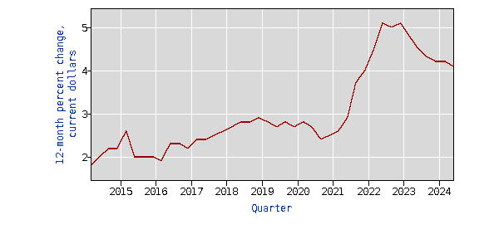
Total compensation All Civilian workers in All industries and occupations, 12-month percent change
Inflationary Pressure:
Total Compensation:
2nd quarter 2024 = 4.1% year over year (no change from 2nd quarter 2023)
Most Current Real Hourly Earnings (real earning increased by 1.0% between June 2023 and June 2024 (seasonally adjusted)
(Source: BLS)
TOTAL COMPENSATION FOR ALL CIVILIAN WORKERS IN ALL INDUSTRIES AND OCCUPATIONS,
12-MONTH PERCENT CHANGE in Current $
Source: Bureau of Labor Statistics

Slide 17
Weakening of Major Manufacturing and Service Industries Indices Pointing to a “potential” Stall in Growth

Slide 18
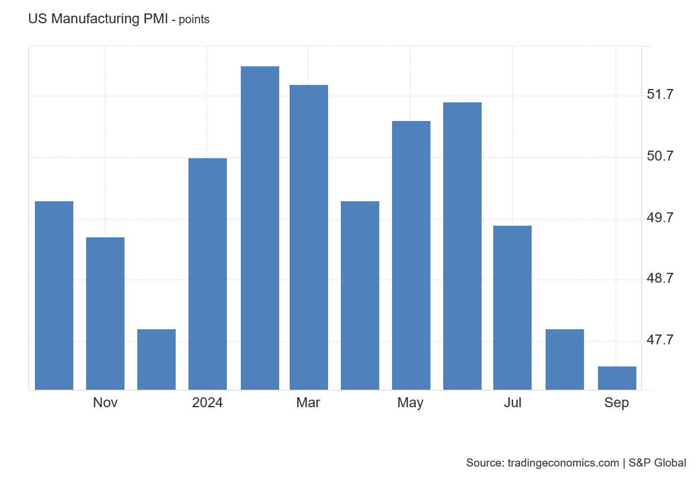
Manufacturing Purchasing Managers New Orders Index
Manufacturers Purchasing Managers New Orders Index (PMI) in September was 47.3
Source: tradingeconommics.com
A PMI reading above 50 percent indicates that the manufacturing economy is generally expanding; below 50 percent indicates that it is generally declining.

Slide 19
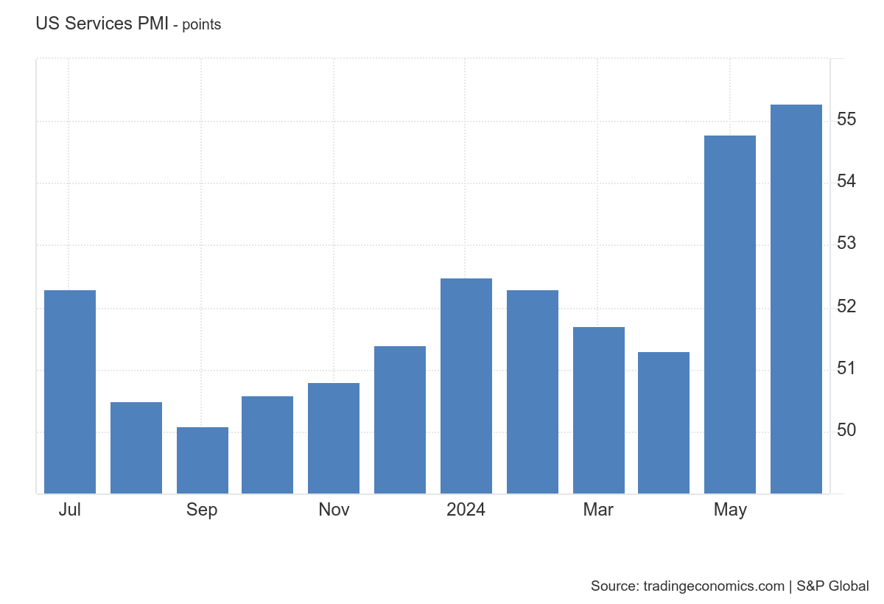
Strengthening Growth
To quote the “Trading Economics” Report:
“ The S&P Global US Services PMI rose to 55.2 in September of 2024 from 55.7 in the previous month, revised higher from the preliminary estimate of 55.4.”
According to Trading Economics statement associated with the current index, “Selling price inflation also accelerated. Despite the growth, business confidence dropped to its lowest level since October 2022 over concerns about an economic slowdown.”
Source: Summary statistics. “Trading Economics”
Services Purchasing Managers Index (PMI)
Source: Trading Economics

Slide 20
Independent Data Still Finds Bottlenecks in Finding Skilled Labor

Slide 21
Openings per hires continue to Contract Wage Pressure likely to Continue to decelerate Openings per Hires continue to fall However, Inflationary Pressures still well above historical levels. Layoffs and discharges at historical low level, implying Reduction in labor turnover Pointing to continued stress on prices from wage inflation. As of August, there were 0.96 job openings for every unemployed (non-seasonally adjusted data) Potential Consequences: rapid slowdown in hiring Excess aggregate Labor downward pressure on wage increase

Slide 22
The Job and Labor Force Situation

Slide 23
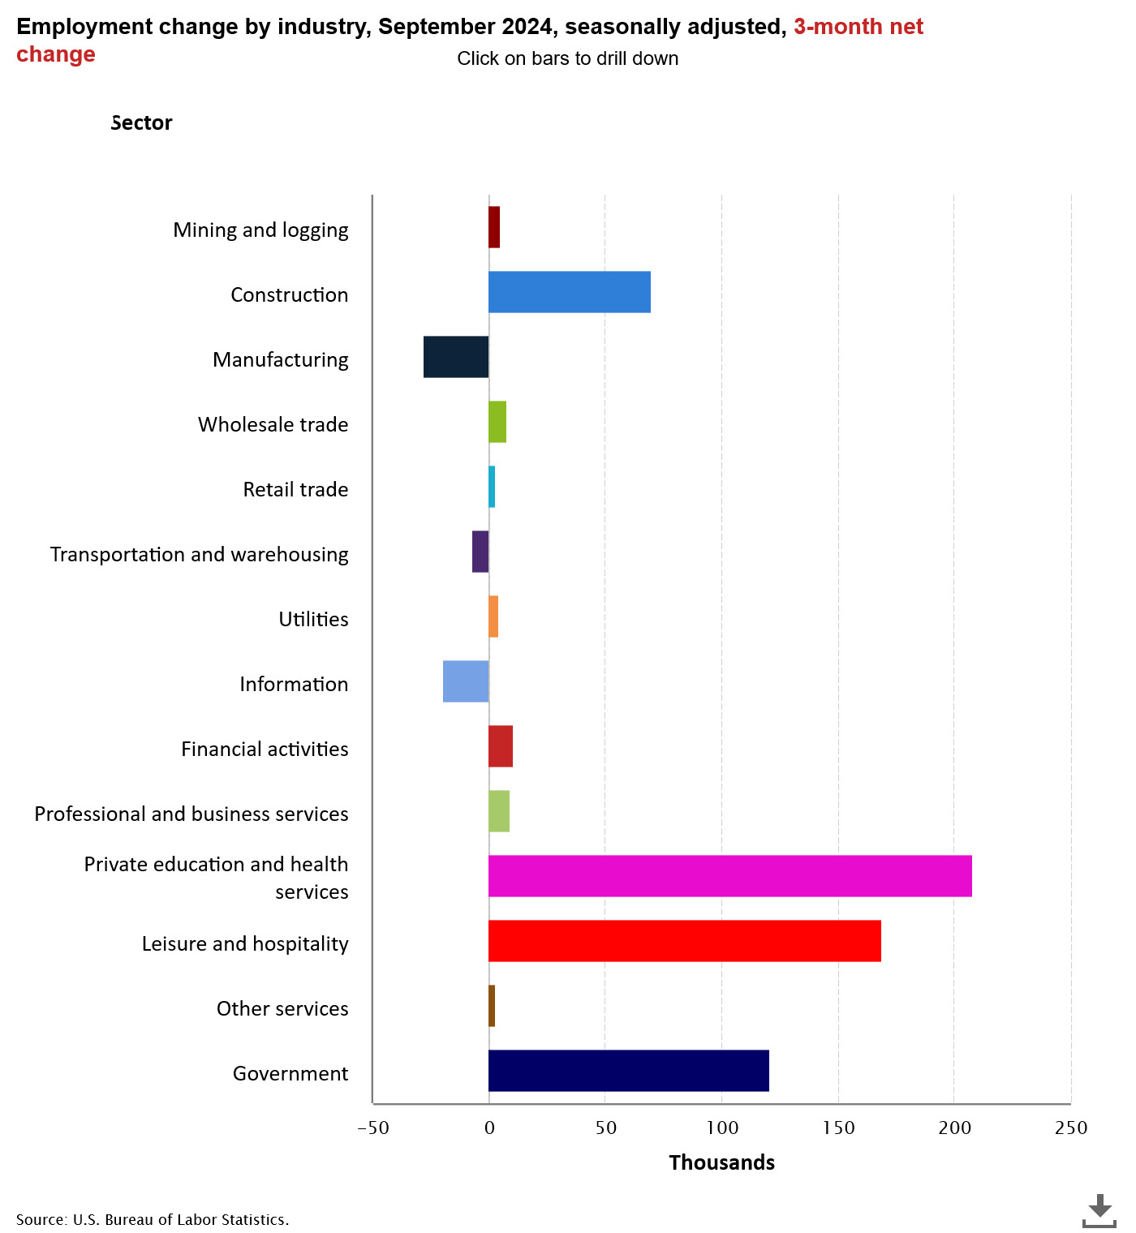
U.S. Employment Change Viewed From A three-month and a twelve-month Change

Slide 24
Year 2008 indicates Participation Rate Pattern Change Primary Causes… Population aging, and Decline in the number of people who want to work (source: National Bureau of Economic Research, “Declining Desire to work and Downward Trends in Unemployment and Participation,” Working Paper 21252, June 2015)

Slide 25
The Problem: Stagnation (see above chart) in Labor force Growth likely limiting Potential Job Growth? Adjusted for Price Inflation, long term Real Potential Personal Income Growth LESS than trend
116574.3
438.8672

Slide 26
A Closer Look At Accommodations and Food Services In Leisure and Hospitality
(Finally) Total U.S. (seasonally adjusted) Employment in Accommodations and Food Services was 62 thousand greater in September 2024 than the previous employment high point of December 2019 (14,336 million jobs). (Source: BLS)
1
Hence, it has taken nearly five years to recover to the previous historical high in jobs in Accommodation and Food Services (December 2019). (Source: BLS) seasonally adjusted
2
In Accommodations and Foods Service in August 2024:
Opening = 915 thousand jobs.
Hires =801 thousand
Layoffs= 120 thousand.
(all data are non-seasonally adjusted)
3

Slide 27
The National Unemployment Situation Percent unemployed Source: BLS Current Population Survey
Seasonally Adjusted
Month | Total | White | Black or African American | Asian | Hispanic or Latino
Dec 2021 | 3.9 | 3.3 | 7.0 | 3.8 | 4.8
Dec 2022 | 3.5 | 3.0 | 5.7 | 2.4 | 4.1
Jan 2023 | 3.4 | 3.1 | 5.4 | 2.8 | 4.5
September | 3.8 | 3.4 | 5.7 | 2.9 | 4.6
October | 3.8 | 3.5 | 5.8 | 3.1 | 4.8
November | 3.7 | 3.3 | 5.8 | 3.5 | 4.6
December | 3.7 | 3.5 | 5.2 | 3.1 | 5.0
Jan. 2024 | 3.7 | 3.4 | 5.3 | 2.9 | 5.0
June | 4.1 | 3.5 | 6.4 | 4.1 | 4.9
September | 4.1 | 3.6 | 5.7 | 4.1 | 5.1

Slide 28
A SNAPSHOT OF
CONSUMER BEHAVIOR
Source: BEA and Census Bureau

Slide 29
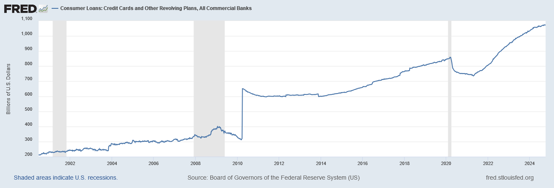
Loans, Credit Card and other Revolving Plans.
Savings Rate as a Percentage of Disposable Income Remains a Historical Low Level. (recall savings rate in “Summary of U.S.” Chart)
Current Debt Level as of September 11, 2024 =$1.063 trillion

Slide 30
Thoughts on the National Outlook
Inflation Down, But Not Out?
Budget Priorities and Distortions in the Marketplace
Background--International Instability

Slide 31
Current Louisiana Economic Outlook:
Key Words:
“Repeat” Concern:
Continued Weak Job Growth
Relative to U.S.
Personal Income Growth Driven by
Dividends, Interest and Rent
Transfer Payments and Health Care
Big increases in Sales and Income Tax Collections are over (see tables)
Sales Tax Collections Combined 1st and 2nd Quarters for 2024 over 2023---5.8% increase
Income Tax Collections Combined 1st and 2nd Quarters for 2024 over 2023---1.96%
Major Long-Term Problems with Inflation Adjusted Labor Productivity, Output and Value-Added Per Worker Growth in Louisiana

Slide 32
Louisiana’s
Sales Tax Collections Slowing
Income Tax Collections Showing Weakness

Slide 35
The Fundamental Problem: Sustainability of Growth--
Stimulus Spending Drying Up, Inflation Eating Away at Consumption and Income

Slide 37
Data Shows: Louisiana Job Economy Significantly
Lagging U.S. Job Growth

Slide 38
The Reality: total number of CES non-farm jobs in Louisiana peaked (post-Hurricane Katrina) in December 2014 at 2.7% above the August 2005 level August 2024 index reading = 100.4 August 2005 = 100

Slide 39
Source: Current Employment Survey, Bureau of Labor Statistics
STATE OF LOUISIANA |  | Total Non-Farm Employment August 2024
Non-Seasonally Adjusted Job Growth August 2023 to August 2024
Construction | 8,800 | 138,600
Health Care and Social Assistance | 6,400 | 292,900
All Others | 3,100 | 126,100
Government | 2,500 | 313,100
Professional and Business Services | 1,200 | 219,400
Wholesale Trade | 400 | 68,400
Support Activities in Transportation | -100 | 19,700
Truck Transportation | -300 | 16,800
Mining | -700 | 30,500
Retail Trade | -1,900 | 214,900
Information | -1,300 | 17,900
Manufacturing | -1,800 | 136,200
Private Educational Services | -200 | 49,600
Financial Activities | -1,700 | 95,600
Leisure and Hospitality | -6,200 | 214,900
Total Change | 8,200 | 1,954,600

Slide 40
Louisiana Leisure and Hospitality Industry: little change in hours worked, Increase in Average Pay

Slide 41
Louisiana’s Personal Income Growth in 2023 Driven by Personal Transfer Payments

Slide 42
Personal Transfer Payments as A Percentage of Total Personal Income: Louisiana’s Personal Income Level Highly Dependent of Transfer Payments 2nd Quarter 2024
Transfer Payments consist of:
Social Security Benefits
Medicare Benefits
Medicare Benefits
All Other transfer Benefits
Transfer Benefits as a percentage of total Personal Income
Louisiana = 24.4%
Alabama = 24.1%
South Carolina = 22.9%
California = 16.4%
Louisiana Transfer Benefits for Medicaid highest among selected states
Louisiana = 6.4% of Total PI
Alabama = 2.9% of Total PI
South Carolina = 3.3% of Total PI
California = 4.4% of PI

Slide 43
Louisiana’s Personal Income Growth Source: Bureau of Economic Analysis
Millions of Current $
Personal Income Change For Select Components
4th Quarter 2019 to 2nd Quarter 2024
Personal income | $61,827
Earnings by place of work | $31,576
plus: Personal current transfer receipts | $20,437
Wage and salary disbursements | $24,083
Proprietors' income | $4,060
Nonfarm proprietors' income | $4,881
Farm earnings | -$678
Nonfarm earnings | $32,253
Private earnings | $28,209
Manufacturing | $2,892
Health and Social Assistance | $5,094
Construction | $3,350
Professional and Technical Services | $2,840
Arts, Entertainment and Recreation | $527
Accommodations and Food Services | $1,134
Mining and Oil and Gas Extraction | -$318

Slide 44
Louisiana
Description | 2019: Q1 | 2020:Q1 | 2022: Q2 | 2023:Q2 | 2024:Q2
Personal income (thousands of dollars, seasonally adjusted) Current $ | $218,293,932 | $221,684,120 | $254,269,017 | $267,224,100 | $282,572,631
Personal current transfer receipts (000) | $47,690,112 | $50,194,856 | $64,707,232 | $65,908,008 | $69,023,253
Social Security Benefits (000) | $14,061,252 | $14,543,116 | $16,177,984 | $18,002,604 | $19,067,115
Medicare benefits (000) | $11,692,100 | $12,259,136 | $14,146,184 | $15,291,668 | $16,288,463
Medicaid (000) | $11,411,812 | $12,071,120 | $16,230,740 | $17,735,208 | $18,112,232
State unemployment insurance compensation (000) | $186,088 | $593,264 | $135,500 | $142,420 | $171,472
All other personal current transfer receipts (000) | $10,338,860 | $10,728,220 | $18,016,824 | $14,736,108 | $15,383,971
Personal Current Transfers as a Fraction of Personal Income | 21.8% | 22.6% | 25.4% | 24.7% | 24.4%
Importance of Transfer Payments as a Fraction of PI
Personal Income Levels
Personal Transfer Payments
Other Transfer Payments
Note: Medicaid Growth
Source: Bureau of Economic Analysis

Slide 45
The Most Worrisome Problem
Structural Changes in Louisiana’s Economy have Created Long Term
Competitive Problems with
Labor Productivity
Output Per Worker
Value-Added and Wealth Creation
Full report found on gnodatacenter.com working paper #3

Slide 46
Definitions
Labor productivity - measures the hourly output of an economy. Specifically, it charts the amount of real gross domestic product (GDP) produced by an hour of labor. Growth in labor productivity depends on three main factors: saving and investment in physical capital, new technology, and human capital.
Output Per Worker- A measure of productivity calculated by dividing the total output by the number of workers.
Real value-added output - removing the effect of price level changes from the nominal value of a good, service, or time-series data, to obtain a truer picture of economic trends.

Slide 47
Louisiana’s Economy is Going Backwards in Key Areas Year 2017= 100

Slide 48
Louisiana’s Economy is Going Backwards in Key Areas Year 2017 = 100

Slide 49
Louisiana’s Economy is Going Backwards in Key Areas Year 2017 = 100
99.0

Slide 51
Source: Office of Productivity, Bureau of Labor Statistics

Slide 52
YOU CANNOT BUILD A STRONG ECONOMY
WITH THESE TYPE OF STATISTICS:
LOUISIANA IN ECONOMIC CRISIS:
Louisiana is Not Successfully Competing
Example: Louisiana vs South Carolina

Slide 53
 | State Gross Domestic Product Growth in Inflation Adjusted $ ( Millions of Chained 2017 $)
 | % CHANGE |  | REAL GDP (IN BILLIONS) CHANGE
Industry | 2012-2023 |  | 2012-2023
 | Louisiana | South Carolina | Louisiana | South Carolina
Mining | -28.3% | 242.1% | -$3,663 | $489
Manufacturing | -20.5% | 14.3% | -$9,413 | $5,925
Wholesale Trade | -5.3% | 33.1% | -$647 | $4,339
Retail Trade | 17.6% | 51.4% | $2,525 | $3,168
Information | 29.9% | 132.0% | $1,217 | $6,760
Professional and Business Services | 17.7% | 60.4% | $3,538 | $9,319
Healthcare and Social Assistance | 39.8% | 52.1% | $6,333 | $3,866
Leisure and Hospitality | 4.7% | 40.2% | $476 | $1,846

Slide 54
Percentage Change in Real Output Per Worker Over Time
 | Change 2007- 2023 | Change 2007-2012 | Change 2012-2023
Alabama | 97.0% | 18.9% | 65.7%
Arkansas | 106.1% | 17.6% | 75.3%
Florida | 142.9% | 3.0% | 135.9%
Georgia | 120.3% | 11.2% | 98.2%
Louisiana | 47.1% | 16.7% | 26.1%
Mississippi | 68.7% | 21.7% | 38.7%
North Carolina | 120.3% | 15.4% | 90.8%
South Carolina | 121.4% | 14.1% | 94.1%
Tennessee | 164.2% | 27.0% | 108.0%
Texas | 150.6% | 26.0% | 98.9%
Virginia | 124.7% | 21.2% | 85.4%
South | 129.1% | 19.4% | 91.8%
Source: Office of Productivity and Technology, Bureau of Labor Statistics

Slide 55
Percentage Increase in Value-Added per Worker in Gross State Product
2007 - 2023
Current $
Value-added Per Worker Increase
in State Gross Product
2007 – 2023
Current $
Tennessee | 83.2%
Virginia | 69.3%
Florida | 68.9%
Alabama | 65.7%
South | 64.9%
North Carolina | 64.4%
Arkansas | 64.3%
South Carolina | 64.1%
Georgia | 61.9%
Mississippi | 59.1%
Texas | 57.4%
Louisiana | 46.9%
Tennessee | $63,497
Texas | $60,491
Virginia | $59,177
South | $56,575
Florida | $55,723
Georgia | $55,444
North Carolina | $53,178
Alabama | $48,064
South Carolina | $45,765
Louisiana | $45,606
Arkansas | $45,188
Mississippi | $40,117
Source: Annual Labor Productivity by State, Bureau of Labor Statistics (May 2024)
Calculated Percentage Change and Growth in Value-Added Per Worker by Systems Solutions Consulting

Slide 56
Example of the Problem: Labor Productivity Index OVER the 2007 to 2023 period by State
Average % Change in the Index Over 2007-2023
Virginia | 1.6
Tennessee | 1.4
Georgia | 1.2
South | 1.1
South Carolina | 1.0
Florida | 1.0
Alabama | 1.0
North Carolina | 0.9
Texas | 0.9
Arkansas | 0.8
Mississippi | 0.5
Louisiana | -0.6
Median % Change of Labor Productivity Index Over 2007 to 2023
Tennessee | 1.8
Georgia | 1.5
North Carolina | 1.2
Texas | 1.2
Virginia | 1.2
Alabama | 0.7
Florida | 0.7
South | 0.7
South Carolina | 0.6
Arkansas | 0.3
Louisiana | 0.1
Mississippi | -0.2
The Problem for Louisiana:
Average Annual Change in the Productivity index over the 2007 to 2023 period was -0.06%
Half of the annual change in the index was above 0.1% or below 0.1%

Slide 57
Unit Labor Costs Increase between 2012and 2023 by Select State Source: office of Technology and Productivity, Bureau of Labor Statistics
Louisiana | 63.6%
Florida | 46.2%
Mississippi | 44.5%
North Carolina | 44.2%
South Carolina | 42.4%
Texas | 40.7%
Alabama | 40.5%
South | 39.0%
Arkansas | 37.6%
Georgia | 36.4%
Virginia | 29.6%
Unit Labor Cost Defined- Ratio of labor compensation per hour divided by product output per hour expressed in current dollars. Compensation/output = unit labor cost

Slide 58
Unit Labor Cost: Another Element of the Economic Crisis
Unit labor Cost is not a problem as long a productivity rises commensurate to increase in labor costs
In Louisiana’s case, the data shows otherwise

Slide 59
New Orleans MSA Outlook: An Economy in Trouble
Key Words:
MSA Job and Wealth Creation Economy Faltering:
Professional and Technical Services:
Starting to Stagnate
Less and Less Industry Diversity and
Occupational Diversity
MSA Population Growth Continues it Downward Spiral
and Particularly Orleans Parish

Slide 60
Latest data shows New Orleans MSA private sector job growth is stagnating.
However, still down by 22,900 private sector jobs in August 2024 compared to February 2020 pre-Covid job level.
Data Includes St. Tammany Parish

Slide 63
New Orleans Metropolitan Statistical Area Non-Farm Non-Seasonally Adjusted Jobs August 2023 to August 2024 |  | Total Non-Farm Jobs | Total Non-Farm Jobs August 2005
 |  | August 2024
Professional and Business Services | 1,900 | 76,000 | 74,300
All Government | 1,600 | 68,700 | 103,900
Health Care and Social Assistance | 1,200 | 77,800 | 62,200
All Others | 900 | 25,400 | 23,600
Transportation, Warehousing & Utilities | 800 | 28,900 | 28,000
Financial Activities | 500 | 29,600 | 33,300
Wholesale Trade | 0 | 22,000 | 26,300
Mining | 0 | 3,200 | 8,500
Private Educational Services | -200 | 32,000 | 18,800
Manufacturing | -500 | 29,500 | 41,500
Information | -700 | 6,500 | 10,500
Construction | -1,000 | 28,200 | 30,100
Retail Trade | -1,500 | 56,000 | 67,500
Leisure and Hospitality | -3,400 | 78,000 | 86,000
Total Change | -400 | 561,800 | 614,500
Source: Bureau of Labor Statistics

Slide 64
GDP Measured in Inflation Adjusted $ for the New Orleans MSA: Value of Aggregate $ output Reflects Greater Reliance on Industries Producing Lower Value output

Slide 65
Current Job Levels for Jefferson, Orleans
and St. Tammany Parishes
Source: Quarterly Census of Employment and Wages
Bureau of Labor Statistics

Slide 67
Key Parish Job Levels
Source: Quarterly Census of Employment and Wages, Bureau of Labor Statistics, Actual Data, January 2007- March 2024, Model Estimates, April to August 2024, Systems Solutions Consulting

Slide 68
Key Parish Job Levels
Source: Quarterly Census of Employment and Wages, Bureau of Labor Statistics, Actual Data, January 2007- December 2023 Model Estimates, January 2024 to June 2024, Systems Solutions Consulting
St. Tammany QCEW job level in September 2022 had recovered all pre-Covid 19 lock-down jobs. August 2024 estimated job level was 5,800 greater than the pre-Covid February 2020 level.
Orleans Parish, as of August 2024, was still down by 15,800 QCEW jobs below the pre-Covid February 2020 level.
Jefferson Parish, as of August 2024, was down by 9,000 QCEW jobs below the pre-Covid February 2020 Level.

Slide 69
Population Levels Labor Market Area 1
Source: U.S. Census Bureau
And Systems Solutions Consulting

Slide 70
 |  | Louisiana | Jefferson | Orleans | Plaquemines | St. Bernard | St. Charles | St. James | St. John | St. Tammany | Labor Market 1
Census | 1900 | 1,384,100 | 15,321 | 287,104 | 13,039 | 5,031 | 9,072 | 20,197 | 12,330 | 13,335 | 375,429
 | 1910 | 1,667,000 | 18,247 | 339,075 | 12,524 | 5,277 | 11,207 | 23,009 | 14,338 | 18,917 | 442,594
 | 1920 | 1,813,000 | 21,563 | 387,219 | 10,194 | 4,968 | 8,586 | 21,228 | 11,896 | 20,645 | 486,299
 | 1930 | 2,105,000 | 40,032 | 458,762 | 9,608 | 6,512 | 12,111 | 15,338 | 14,078 | 20,929 | 577,370
 | 1940 | 2,370,000 | 50,427 | 494,537 | 12,318 | 7,280 | 12,321 | 16,596 | 14,766 | 23,624 | 631,869
 | 1950 | 2,697,000 | 103,873 | 570,445 | 14,239 | 11,087 | 13,363 | 15,334 | 14,861 | 26,988 | 770,190
 | 1960 | 3,260,000 | 208,769 | 627,525 | 22,545 | 32,186 | 21,219 | 18,369 | 18,439 | 38,643 | 987,695
 | 1970 | 3,644,637 | 337,568 | 593,471 | 25,225 | 51,185 | 29,550 | 19,733 | 23,813 | 63,585 | 1,144,130
 | 1980 | 4,223,101 | 454,592 | 557,515 | 26,049 | 64,097 | 37,259 | 21,495 | 31,924 | 110,869 | 1,303,800
 | 1990 | 4,219,973 | 448,306 | 496,938 | 25,575 | 66,631 | 42,437 | 20,879 | 39,996 | 144,508 | 1,285,270
 | 2000 | 4,468,886 | 455,466 | 484,674 | 26,757 | 67,229 | 48,072 | 21,216 | 43,044 | 191,268 | 1,337,726
Census Estimates | 1-Jul-01 | 4,477,875 | 453,154 | 487,363 | 27,029 | 68,028 | 48,461 | 21,291 | 43,580 | 195,622 | 1,344,528
 | 1-Jul-02 | 4,497,267 | 453,429 | 489,722 | 27,462 | 68,964 | 49,117 | 21,365 | 43,878 | 200,701 | 1,354,638
 | 1-Jul-03 | 4,521,042 | 454,533 | 492,187 | 28,169 | 69,621 | 49,338 | 21,274 | 44,316 | 205,708 | 1,365,146
 | 1-Jul-04 | 4,552,238 | 456,602 | 493,765 | 29,390 | 70,547 | 49,939 | 21,229 | 44,822 | 211,405 | 1,377,699
 | 1-Jul-05 | 4,576,628 | 456,554 | 494,294 | 29,558 | 71,300 | 50,670 | 21,399 | 45,296 | 217,358 | 1,386,429
 | 1-Jul-06 | 4,302,665 | 426,285 | 230,172 | 22,329 | 16,563 | 52,453 | 21,964 | 47,296 | 223,133 | 1,040,195
 | 1-Jul-07 | 4,375,581 | 432,683 | 268,751 | 22,709 | 23,613 | 52,765 | 22,164 | 47,386 | 226,294 | 1,096,365
 | 1-Jul-08 | 4,435,586 | 431,759 | 301,842 | 22,677 | 28,879 | 52,516 | 22,095 | 46,811 | 229,252 | 1,135,831
 | 1-Jul-09 | 4,491,648 | 431,921 | 327,803 | 22,730 | 32,878 | 52,719 | 22,231 | 46,336 | 231,224 | 1,167,842
Census | 2010 | 4,533,372 | 432,552 | 343,829 | 23,042 | 35,897 | 52,780 | 22,102 | 45,924 | 233,740 | 1,189,866
Census Estimates | 1-Jul-10 | 4,544,996 | 432,755 | 347,903 | 23,123 | 36,813 | 52,844 | 22,006 | 45,624 | 234,568 | 1,195,636
 | 1-Jul-11 | 4,575,625 | 434,089 | 360,735 | 23,582 | 39,516 | 52,390 | 21,784 | 45,066 | 236,846 | 1,214,008
 | 1-Jul-12 | 4,600,972 | 433,954 | 369,787 | 23,826 | 41,483 | 52,420 | 21,634 | 44,719 | 239,064 | 1,226,887
 | 1-Jul-13 | 4,624,527 | 434,264 | 378,637 | 23,509 | 43,430 | 52,614 | 21,607 | 43,570 | 241,953 | 1,239,584
 | 1-Jul-14 | 4,644,013 | 434,078 | 383,940 | 23,304 | 44,439 | 52,678 | 21,515 | 43,714 | 245,237 | 1,248,905
 | 1-Jul-15 | 4,664,628 | 435,175 | 389,742 | 23,437 | 45,421 | 52,572 | 21,481 | 43,523 | 248,930 | 1,260,281
 | 1-Jul-16 | 4,678,135 | 436,572 | 391,843 | 23,323 | 45,777 | 52,796 | 21,433 | 43,401 | 252,468 | 1,267,613
 | 1-Jul-17 | 4,670,560 | 436,126 | 391,493 | 23,348 | 46,110 | 52,620 | 21,380 | 43,328 | 255,921 | 1,270,326
 | 1-Jul-18 | 4,659,690 | 433,884 | 391,004 | 23,385 | 46,780 | 52,775 | 21,151 | 43,119 | 258,035 | 1,270,133
 | 1-Jul-19 | 4,648,794 | 432,493 | 390,144 | 23,197 | 47,244 | 53,100 | 21,096 | 42,837 | 260,419 | 1,270,530
Census | 2020 | 4,657,757 | 440,781 | 383,997 | 23,515 | 43,764 | 52,549 | 20,192 | 42,477 | 264,570 | 1,271,845
Estimates | 1-Jul-20 | 4,652,022 | 439,725 | 383,241 | 23,460 | 43,856 | 52,513 | 20,120 | 42,366 | 265,000 | 1,270,281
 | 1-Jul-21 | 4,627,047 | 434,134 | 377,346 | 23,310 | 44,324 | 52,470 | 19,794 | 42,109 | 270,147 | 1,263,634
 | 1-Jul-22 | 4,588,023 | 426,030 | 369,917 | 22,618 | 44,419 | 51,058 | 19,388 | 39,955 | 273,237 | 1,246,622
 | 1-Jul-23 | 4,573,749 | 421,777 | 364,136 | 22,386 | 44,463 | 50,620 | 19,191 | 39,592 | 275,583 | 1,237,748
 | Source: U.S. Census Bureau; Systems Solutions Consulting

Slide 71
Multiple Sources and Notes: Years 1920, 1930, 1960, 2000, 2010 and 2020 are April 1 actual U.S. Census data counts. Years 2011-2019 reflect July 1 estimates of the U.S. Census Bureau. Years 2015 to 2019 of the 2011 to 2019 data series reflect adjustments made by Systems Solutions Consulting to Census Bureau estimates to reflect the population trend toward 2020 U.S. Census Bureau April 1 actual population count. The years 2021-2023 reflect the continuation of July 1 Census estimates. The year 2024 reflects Systems Solutions regression model estimate. Specifically, the population estimate is for September 2024. Current Census time series data covers the period 2006 to 2023. The Census model was updated in March 2024 with the inclusion of July 2023 data from the U.S. Census Bureau.
All data estimates from the Systems Solutions model for the non-Census Bureau data years are based upon monthly postal survey data as one input. Postal survey data are gathered from “The Data Center-New Orleans” web site https://www.datacenterresearch.org
Note on errors: The Systems Solutions model estimated July 2023 New Orleans population total population at 368,176. The Census Bureau estimate for July 2023 was a population of 364,136. Hence, the model difference was 4,040 higher than the Census Bureau estimate or 1.1% difference.

Slide 72
Summary
NATIONAL ECONOMIC PICTURE
PRICE INFLATION STILL “STICKY”… Trend is downward…Wage-Price Inflation May Upset the “APPLE CART”
LACK OF CLARITY ON INTEREST RATE DIRECTION
INTERNATIONAL INSTABILITY-- MAJOR BACKGROUND PROBLEM TO MODERATING INFLATION
LOUISIANA JOB RECOVERY: SLOW TO STAGNANT
STATE REVENUE GROWTH SUBSTANTIALLY SLOWING
PREVIOUS GROWTH DISGUISED STRUCTURAL WEAKNESS IN STATE ECONOMY
DATA SUGGESTS MAJOR ISSUES WITH PRODUCTIVITY, OUTPUT PER WORKER AND VALUE-ADDED
NEW ORLEANS MSA ECONOMY RECOVERY: WEAK AND GETTING WEAKER: LOTS OF UNDERLYING ISSUES
LEISURE AND HOSPITALITY RESTRUCTURING? … IMPACT ON LABOR DEMAND
TECHNICAL AND SCIENTIFIC SERVICES JOB GROWTH BOTTOM FALLING OUT
POVERTY AND CRIME…
POPULATION GROWTH CONTINUES STAGNATION PATH
CENSUS BUREAU HAS REDEFINED NEW ORLEANS MSA AREA: ST.TAMMANY PARISH REMOVED RESULTING IN NEW ORLEANS MSA POPULATION FALLING TO LESS THAN ONE MILLION POPULATION

